Slide 1
Notes for facilitator
See slide notes
Notes:
Note to facilitator: This slide is hidden and will not present in “Slide Show” mode.
This facilitation guide and associated slides are intended to support group facilitation of the What Are Data? Action Learning Guide content from the County Health Rankings & Roadmaps program. You will note that we use “data” consistently as a plural noun throughout the content, but standards of English recognize it as both a plural and singular noun.
The slides are grouped into content sections with headers that begin with numbers. These sections may be helpful if you intend to facilitate the content over multiple sessions. If you decide to facilitate the content in sections, we recommend returning to and reviewing Section 1.0 “Ground Setting” before each session.
You may use the notes sections on each slide as a script which may be read aloud or adapted to your preferred way of speaking. Please feel encouraged to include examples, stories, context, or local data that help your audience meet their objectives and needs.
Before beginning, we recommend each learner receive the companion worksheet to the Action Learning Guide. You may encourage everyone to utilize the worksheet digitally (https://www.countyhealthrankings.org/sites/default/files/media/document/chrr_whataredata_worksheet.pdf) or by providing printed copies.
Finally, please feel encouraged to reach out to County Health Rankings & Roadmaps if you have any questions about content or facilitation: https://www.countyhealthrankings.org/about-us/contact-us

Slide 2
Starting Questions
What do you think of when you hear the term “data”?
What kind of experiences do you have working with data?
What’s one time when you’ve enjoyed working with data?
Notes:
Note to facilitator: This slide is hidden and will not present in “Slide Show” mode.
Consider asking one, two or all of the slide questions before the beginning the presentation.

Slide 3
What Are Data?
Last updated:
May 15, 2020
Slides for Group Facilitation
countyhealthrankings.org
Notes:
Across the country, people are working to create communities where everyone has the opportunity to live their healthiest life.
Data can help a community tell their story. Data can focus on past and present context, including the history of laws, policies, practices and budgets that impact health. Data are pieces of information that help us understand the world in which we live.
This presentation will help you understand how to find and begin to use data. You may also use it to create a common understanding among partners about what data are and why they matter.
This is the right place if you:
Have looked at data about your community but want to better understand what kinds of data are available and why they matter.
Are looking for guidance, tools, and examples to help you get started using data.
Data can be useful to inform many efforts. In your community, people may use data to:
Assess the health of your community, including areas of strengths.
Identify root causes of health issues.
Prioritize where to take action.
Track progress.
Support decision-making and policy change.
Identify and address health inequities.

Slide 4
How are data represented?
numbers
documents
stories
first-person narratives
photographs
maps
graphics
words
measurements
observations
descriptions
Notes:
Data can be presented as [facilitator: read list from slide]
Audience prompt: Can you think of any additional ways that data might be presented?
Using data to understand and assess the health of a community and can help you:
Identify strengths and assets to build upon.
Decide how to best allocate resources.
Understand values and experiences.
Prioritize efforts to improve health for all.
Data can lead you to assess health among groups of people as well as across the geography of your community.

Slide 5
What is Health?
Population Health | The health outcomes of a group of individuals, including the distribution of outcomes within the group. These groups are often geographic populations such as nations or communities but can also be other groups as identified by race or ethnicity, persons with disabilities, people who are incarcerated, or any other defined group (Kindig & Stoddart, 2003; Kindig 2007).
Population | The whole group that is being studied or measured.
Community | Your defined population of interest. In the world of health improvement, community is often defined as a group of people affiliated by: Place, such as neighborhood, city, county, parish, or borough. Shared interests, such as the environment, schools, or spirituality. Similar situations, such as immigrant communities or people experiencing poverty. Identity, such as race, ethnicity, gender, or sexual orientation.
Notes:
Throughout this discussion, we’ll refer to “health.” We define health in the broadest possible terms. On the screen are a few terms we’ll use throughout our discussion.
Think of all the things that affect our health: sure, we could all eat better, move more, and make sure we get our annual check-ups, but there’s much more. The quality of our homes, the safety of our neighborhoods, and our chance at a good education all influence health in the short and long term.
For some people, the essential elements for a healthy life are readily available. But for others, the opportunities for healthy choices are limited.

Slide 6
Learning objectives
Define data.
Understand the difference between qualitative and quantitative data.
​​​​​​​​​​​​​​Differentiate between quantitative and qualitative methods of measuring the health of populations.
Describe different methods for measuring the health of a population.
Examine common sources of community health data.
Interpret county snapshots from County Health Rankings & Roadmaps.
Notes:
Note to facilitator: Review the learning objectives with your group and ask for reflections on items particularly pertinent to your community and/or places of strength/weakness that currently exist in your work.

Slide 7
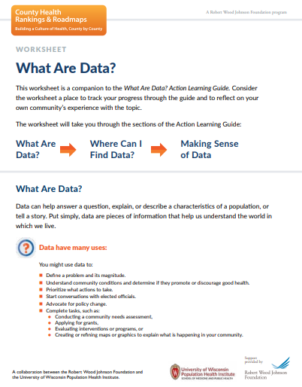
What you can expect
Learn from the content.
Learn from discussion and reflection.
Learn from taking action.
Notes:
Note to facilitator: This is a great time to introduce the companion worksheet to the Action Learning Guide. You may encourage everyone to utilize the worksheet digitally (https://www.countyhealthrankings.org/sites/default/files/media/document/chrr_whataredata_worksheet.pdf) or by providing printed copies.
_____________________________________________
Learn from the content provided here:
The guidance, tools, and examples included here will help you develop a deeper understanding of data.
Learn from discussion and reflection:
You will find discussion questions throughout to help you apply the learning as you go. Use the companion worksheet to capture your reflections and learnings.
Learn from action
This guidance will continue to help as you put what you learn into action. You will practice with tips and tools to help you act along the way.

Slide 8
Using Data
Define a problem and its magnitude.
Understand community conditions.
Prioritize what actions to take.
Start conversations.
Advocate for policy change.
Complete specific tasks, such as:
Conduct a community needs assessment.
Apply for grants.
Evaluating interventions or programs.
Creating or refining maps or graphics.
Notes:
If you’re working to improve the health of people living in your community, data are a useful and necessary tool. Data can help answer a question, explain or describe characteristics of a population, or tell a story.
Put simply, data are pieces of information that help us understand the world in which we live.
Note to facilitator: Encourage learners to reflect on uses of data as listed on the screen
Audience prompt: Can you think of any additional actions or tasks that data could support?
Data answer many questions such as:
How much?
How many?
Where?
How likely?
How?
Why?
What’s the impact?
Data can inform the work you do in your community. As you can tell by the many ways you might use data and the range of questions you can answer, data come in many forms.
Data that describe specific health issues in your community may have already been collected, analyzed, and made available by researchers, community members, public health professionals, or media. In this case, you might just have to identify the keepers of the data.

Slide 9
Discussion & Reflection
What questions do you have about the health of your community?
How could you use data to answer those questions?
Notes:
Note to facilitator: This slide is meant to be a learning check on the “Define data” learning objective.
The slide is animated and questions will appear one at a time. These discussion prompts are great for group discussion and can also be completed on the individual worksheet.
Consider starting the participants with individual reflection and then group reflection will reinforce learning. You can do this by suggesting, “Take five minutes to write your own thoughts on the worksheet, then we’ll come together as a group to discuss this.”

Slide 10
Quantitative Data
Numbers
Notes:
Data can be quantitative or qualitative.
Quantitative data are described using numbers and statistics.
We’ll spend the next few slides investigating some examples of quantitative data.
First, Numbers:
Numbers represent a quantity or amount.
For example:
The city experienced 100 new cases of the flu in the last week.

Slide 11
Quantitative Data
Proportions & Percentages
Notes:
Next, proportions and percentages. A percentage tells you the parts per 100. It is used to measure the occurrence of a condition in a group of people.
For example:
“27% of households in California experience at least one severe housing problem” means that “27 of 100 households experience at least one severe housing problem.”

Slide 12
Quantitative Data
Mean
Notes:
The mean is the average of all numbers. To calculate it:
add up all the data points,
then divide by the number of data points.
For example:
In the first week of the month, the city experienced 100 new cases of the flu.
In the second week, the city experienced 75 new cases of the flu.
In the third and fourth weeks, the city experienced 85 new cases of the flu.
In the last week, the city experienced 63 cases of the flu.
To figure out the average number of new flu cases experienced each week we would:
Add up all the data points: 100 + 75 + 85 + 85 + 63= 408
Divide by the number of data points: 408/5 = 86.5
Result: The city experienced an average of 86.5 new flu cases each week over the last month.

Slide 13
Quantitative Data
Median
Notes:
The median is the middle of a sorted list of numbers.
To find the median, place the numbers in value order from lowest to highest and find the middle number.
For example:
To figure out the median number of new flu cases experienced each week we would:
Sort all the data points from lowest to highest: 63, 75, 75, 85, 100 Select the middle data point (75).
Result: The city experienced a middle value of 75 new flu cases when comparing each week over the last month.
It’s easy to confuse the “mean” and the “median.” The median and the mean both measure tendency. But unusual values, or outliers, affect the median less than they affect the mean. It’s useful to look at all of your data points, checking for outliers, before deciding which method represents your data best.

Slide 14
Quantitative data
Rate
Notes:
Rates are a comparison of a condition between two populations. They are often communicated in the style of "this per that."
Rates are useful for comparing different groups such as counties, races, or points in time.
For example:
The violent crime rate in Lubbock County, Texas is 863 crimes per 100,000 population in the 2019 County Health Rankings.
Note to Facilitator: This may be a good time to pause to review any questions about “Numbers,” “Proportions & Percentages,” “Mean,” “Median,” and “Rate.” Coming up with new examples may help solidify the content.

Slide 15
Qualitative Data
Observations
Notes:
Note to facilitator: You have just completed a section on “quantitative data.” The next few slides will focus on qualitative data. It may be helpful to note the transition with your audience.
Qualitative data include descriptions, viewpoints, quotes, historical context, and explanations.
Qualitative data can help to identify and explain
strengths,
needs, or
gaps between groups within your community.
Qualitative data provides context and can help you understand people’s experiences in a community.
We’ll spend the next few slides investigating some examples of ways that qualitative data is collected.
First, Observations:
In observation, you record what you find as you:
look at a place or event,
watch situations or interactions, or
take part in the life of the community or a population.

Slide 16
Qualitative Data
Key Informant Interviews
Notes:
Next is Key Informant Interviews
Key informant interviews are in-depth one-on-one discussions to gather input from community members. You might interview key community leaders or residents representing specific groups (perhaps, pregnant teenagers, or Latinx men).
Key informants are not always traditional leaders or influencers. It is important to remember that people know their own reality better than anyone. Therefore, conducting interviews with those that may not traditionally be viewed as an "expert" and connecting with non-traditional partners is key to understanding varied perspectives across a wide range of experiences.

Slide 17
Qualitative Data
Focus Groups
Notes:
Focus groups gather information and opinions from groups of 6-12 participants who belong to a subgroup of interest (perhaps, women aged 35-40 or teenagers who smoke cigarettes). A trained facilitator leads the discussion. The group's conversation will be guided by a scripted set of questions, but the conversation is likely to be fairly free-flowing and open-ended.
Participants are encouraged to discuss among themselves, in response to a guiding question from the facilitator. This often sparks memories or comparisons with one's own experience and can often generate more data than a one on one interview. Confidentiality is important, however; if you believe that this could result in fear of saying something that may feel too personal or risky. If confidentiality is an issue, a key informant interview might be a better choice.

Slide 18
Qualitative Data
Community Meetings
Notes:
Community or other large meetings allow a range of people a chance to express their opinions and react to others. They can draw on a large pool of opinions and knowledge at one time. They also help to surface disagreements or differences that can then be discussed. Notes or minutes taken at these meetings can be an invaluable source of data.

Slide 19
Qualitative data
Review of Documents
Notes:
Documents such as existing reports, program logs, performance ratings, funding proposals, meeting minutes, newsletters, print media, and marketing materials can be reviewed to harvest important data. This is an important way to gather background data or to provide historical context.
If you’re thinking about collecting qualitative data, map out your plan before you start gathering data.
How will you gather data?
Who will you collect data from?
What do you want to learn?
How will you organize your information?
How will you analyze the information?
How will you share what you learn?
Note to Facilitator: This may be a good time to pause to review any questions about “Observations,” “Key Informant Interviews,” “Focus Groups,” “Community Meetings,” and “Review of Documents.” Coming up with new examples or additional ways of collecting qualitative data may help solidify the content.

Slide 20
Activity: Which type of data is this?
6% of children in Scott County are born with low birthweight.
For every dentist in Reynolds County, there are 1250 people.
Survey responders indicated favoring smoke free campuses.
Roberta and Anita spoke at the City Council meeting about expanding safe bicycling options.
64 people in Alfalfa County were employed.
Notes:
Note to facilitator: The slide is animated and data measures will appear one at a time. First, have participants assess whether the measure is quantitative or qualitative, and then encourage them to be as specific as possible.
6% of children in Scott County are born with low birthweight. (Quantitative, Percentage)
For every dentist in Reynolds County, there are 1250 people. (Quantitative, Ratio)
Survey responders indicated favoring smoke free campuses. (Qualitative, perhaps gathered in focus group)
Roberta and Anita spoke at the City Council meeting about expanding safe bicycling options. (Qualitative, perhaps gathered at a community meeting or in review of documents)
64 people in Alfalfa County were employed. (Quantitative, Numbers)

Slide 21
Knowledge Check
Which words describe types of quantitative data?
Which words describe types of qualitative data?
Explanations
Counts
Viewpoints
Percentages
Rates
Descriptions
Notes:
Note to facilitator: This slide is meant to be a learning check on the “Understand the difference between qualitative and quantitative data,” ​”​​​​​​​​​​​​Differentiate between quantitative and qualitative methods of measuring the health of populations data” and “Describe different methods for measuring the health of a population” learning objectives.
Look to both qualitative and quantitative data for a more complete picture of your community.
You may start with quantitative data to identify strengths or needs in the community. Then use qualitative data to explore why a problem exists and what it means for the people most affected. Qualitative data may not tell the same story as you see in quantitative data.
Audience prompt:
Which words describe types of quantitative data?
Which words describe types of qualitative data?
You could also start with an observation or stories from community members. This is qualitative data. From there, you might search for existing quantitative data that help you define the magnitude of the problem or what you can do about it.
Neither approach is right or wrong.
Your approach may be completely different than another community trying to answer the exact same question. And your approach may change each time you use data based on what data are available or other community conditions.
There are many types of data, and your unique needs will guide what you should use.

Slide 22
Data in Action
Notes:
Using both qualitative and quantitative data together can provide a broader view of experiences in a community.
Garrett County, Maryland, a 2017 Robert Wood Johnson Foundation Culture of Health Prize winner, uses an innovative way to gather both qualitative and quantitative data from its residents.
Note to facilitator: Play the video at this time. The video is set to begin at the 3:40 mark, but it will not automatically stop at the end of the discussion of data application (~4:30).
More than 63,000 residents have engaged in Garrett County’s community health planning processes by using the Garrett County Planning Tool. There are over 150 Action Groups on the platform, which are public groups formed and monitored by community members, stakeholders and policymakers around a variety of health improvement topics, ranging from oral health outreach to overdose response training. From these Action Groups, nearly 900 quantitative data sets have been mined and tracked on the platform.
On the Garrett County Planning Tool users can also gather qualitative data points through keyword searches of the Action Groups and through targeted searches on the platform’s Community Pulse tool, which syndicates local social media feeds. The layering of this qualitative data helps the Garrett County Health Department better understand the needs of their community in real time.
As a result of their blending of qualitative and quantitative data, Garrett County better understands the issues its residents face, and can work with the community to find solutions.
Audience prompt: What are some ways you’re using quantitative data in your work? Qualitative data?

Slide 23
Key Takeaways
Quantitative data are described used numbers and statistics.
Qualitative data includes descriptions, viewpoints and explanations.
Qualitative and quantitative data should be used together for a more holistic picture of your community.
Photo by Austin Distel on Unsplash
Notes:
Note to facilitator: The slide is animated and key takeaways will appear one at a time. These points are great moment for group reflection before moving on to the next content section.

Slide 24
Primary and Secondary Data
Existing data (secondary data) | Gathered by someone else. Commonly found through national, state, and local agencies and organizations. Often publicly available through a range of sources.
Your own data (primary data) | Gathered by you. Allows control over which questions you ask. Can help to tell a more complete story. Provides an opportunity for community participation. May be gathered through surveys, interviews, focus groups and observations.
Notes:
There are two ways to get data to answer your questions—using existing data or collecting your own.
You can start with existing data, also known as secondary data. What data already exist for your community?
If you can’t answer your questions with existing data, you may need to collect your own. This is generally referred to as primary data.
Note to facilitator: Review the chart with participants and discuss any questions.
Both primary and secondary data are useful for many purposes, including:
Program evaluation,
Understanding your community, a population or client base, and
Uncovering community strengths or needs.

Slide 25
Collecting Primary Data
In groups, explore “Listening to the Community: A Guide to Primary Data Collection tool.”
Review “Selecting the Best Approach” on page 3 of the document.
Review the brief overview of your selected method.
Which methods have you used to collect data in your community?
Which methods do you want to learn more about?
What key questions are addressed by your selected method?
Photo by Dylan Gillis on Unsplash
Notes:
Note to facilitator: This exercise is harvested from the “Listening to the Community: A Guide to Primary Data Collection tool” (https://www.countyhealthrankings.org/sites/default/files/media/document/resources/Listening_to_the_Community.pdf) from the Wisconsin Association of Local Health Departments and Boards.
CHR&R staff often refer practitioners to this tool when they are thinking about collecting primary data. It offers guidance on when and how to use interviews, focus groups, community surveys, community forums, and observation.
Print this document in advance or provide access to it via computer or mobile phone to allow users to explore the exercise.
Instructions:
Place the participants into 5 groups.
Assign each group a primary data collection approach
Key Informant Interviews
Focus Groups
Community Surveys
Community Forums
Direct Observation
Encourage the groups to review the document and address the questions on the screen. [XX minutes]
Discuss each group’s exploration in a large group. [XX minutes]

Slide 26
Common places to find existing data
Documents, reports and websites
Local or state government agencies, such as planning or public health departments.
Healthcare organizations, such as nonprofit hospitals or Federally Qualified Health Centers.
Partners
Community Development Corporations
Community Action Programs
University Extension programs
Chambers of Commerce
Local United Ways
Nonprofit organizations
Notes:
A few common places to find secondary data include:
Documents or reports. Several organizations and institutions conduct assessments or release reports. These sources may have existing data you could use. Check out:
Local or state government agencies, such as planning or public health departments.
Healthcare organizations, such as nonprofit hospitals or Federally Qualified Health Centers.
Other partners such as Community Development Corporations, Community Action Programs, University Extension programs, Chambers of Commerce, local United Ways, and nonprofit organizations.
Audience prompt:
Have you used any of the sources listed on the screen?
What are some other sources of documents or reports?

Slide 27
Common places to find existing data
Datasets
500 Cities
Child Opportunity Index
City Health Dashboard
County Health Rankings & Roadmaps
Data Across Sectors for Health (DASH)
The Health Opportunity and Equity (HOPE) Initiative
National Equity Atlas
Opportunity Atlas
United States Small-Area Life Expectancy Estimates Project (USALEEP)
Well Being in the Nation (WIN) measures
Notes:
Datasets. Several datasets are available through federal public health surveillance systems. Public health surveillance is the continuous, systematic collection, analysis, and interpretation of health-related data.
The Power of Data for Healthy Communities report (https://www.rwjf.org/en/library/research/2018/04/the-power-of-data-for-healthy-communities.html) from the Robert Wood Johnson Foundation highlights several data sources available with local health data. Consider exploring them as you have time:
500 Cities
Child Opportunity Index
City Health Dashboard
Data Across Sectors for Health (DASH)
The Health Opportunity and Equity (HOPE) Initiative
National Equity Atlas
Opportunity Atlas
United States Small-Area Life Expectancy Estimates Project (USALEEP)
Well Being in the Nation (WIN) measures
Audience prompt:
Have you used any of the sources listed on the screen?
What are some other datasets you have used?

Slide 28
Find More Data: Resource exploration
Discussion & Reflection
How many National Data Sources are included?
What are some National Data Sources you’d like to explore later?
How many State-Specific Data Sources are included for your state?
Which data sources have you used in your community?
Notes:
Note to facilitator: This exercise from the County Health Rankings & Roadmaps (https://www.countyhealthrankings.org/explore-health-rankings/use-data/go-beyond-the-snapshot/find-more-data) can be explored on screen as a group.
The Find More Data resource on the County Health Rankings website can link you to some important national- and state-level secondary data sources to consider.
The header of the slide is clickable and will direct you to the appropriate web page.
Two additional questions to consider as audience prompts (you may also include some of your own).
How many sources provide data broken down by demographics (e.g., age, sex, or race/ethnicity)?
How many sources provide data for areas smaller than the county (e.g., cities, ZIP codes, or school districts)?

Slide 29
Key Takeaways
Secondary data are data that already exist.
Primary data are data that you collect yourself.
All types of data are useful and together can tell a more complete story about the strengths and needs in your community.
Notes:
Note to facilitator: This slide is meant to be a learning check on the “Examine common sources of community health data.” learning objective.
The slide is animated and key takeaways will appear one at a time. These points are great moment for group reflection before moving on to the next content section.

Slide 30
Get to know your data
When were the data collected?
Who collected it?
Can you break it down in the ways you need?
What is its geographic scale?
For what purpose were data collected?
Photo by Christina @ wocintechchat.com on Unsplash
Notes:
Once you find one or more sources of data, the next step is to begin to make sense of the data.
Get to Know Your Data
Getting to know key details about your data sources can help you be sure you're working with data that meet your needs.
When were the data collected?
Who collected it?
Can you break it down in the ways you need? (e.g., by age, gender, race, education, income, subcounty area)
What is its geographic scale? (city, neighborhood, county, Census tract, Congressional district)
For what purpose were data collected? (e.g., administrative, Census, public health surveillance)
Do the data you've found meet your needs? They might not.
Are there gaps in the data by race? By place? What’s missing?
The data you find may not always be a perfect for your needs. Sometimes that means you’ll want to collect your own data. Sometimes that means you move forward with the best data available and accept that there are some limitations.

Slide 31
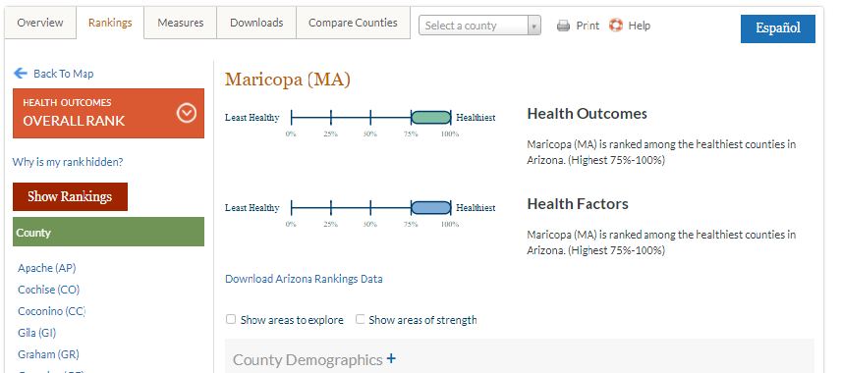
Get to know your county health rankings Snapshot
Measure name
County Value
Error margin
Top U.S. Performers
State Values
Rank
Additional Measures
Notes:
There are many sources of data. Our main data tool at County Health Rankings, the county snapshot, can help you start learning how to find and make sense of already existing data.
Note to facilitator, leave this slide to view the County Health Rankings snapshot for your county.
Go to Explore Health Rankings at County Health Rankings & Roadmaps (https://www.countyhealthrankings.org/explore-health-rankings)
Enter your state or county name under Find County Rankings.
Select your county. This brings you to the County Health Rankings snapshot for the current year.
Within the snapshot you will see several key elements:
Within the snapshot you will see several key elements:
County name
Text at the top of the snapshot that identifies which county’s data you are reviewing.
Quartile graphics
These charts show you with which group of counties your county's health factors and health outcomes data align.
Side navigation bar
Allows you to toggle on your state's county rankings and to easily select from other counties in your state.
Measure name
Text in the left most column.
County value
These are your county’s data for each measure. We report values for the 35 measures we use to calculate ranks and additional measures.
Error margin
This is a fancy way to talk about how much certainty we have in each measure estimate. These should be interpreted as “we are 95% confident that the true value for the county lies between XX and YY.”
Top U.S. performers
For many Rankings measures, we have displayed the value for which only 10% of counties in the country are doing better, i.e., the 90th percentile or 10th percentile, depending on whether the measure is framed positively (e.g., high school graduation) or negatively (e.g., adult smoking).
State values
Each county's corresponding state values are included for comparison.
Additional measures
You'll notice grey boxes that contain plus signs. Each of these grey boxes can be expanded to reveal additional health measures and data for your county.
Rank
For each ranked county, there are eight ranks that you may view in the snapshot:
Health outcomes,
Health factors,
One each for the two types of health outcomes:
length of life
quality of life
One for each of the factors themselves:
health behaviors,
clinical care
social and economic, and
the physical environment.

Slide 32
Making sense of your snapshot
Discussion & Reflection
How healthy is your county?
Is this what you expected?
Why?
Notes:
Now let’s break down what this data means.
Look to your Ranks to understand the big picture of health in your county
To understand the health of your community broadly, start by finding the Health Outcome and Health Factor ranks.
How healthy is your county?
Is this what you expected?
Why?
By answering these questions, you have now started to apply observations and interpretations to the quantitative data provided in the snapshot itself.
Note to facilitator: Continuing this exploration with your county’s slide will allow participants to further investigate local data.

Slide 33
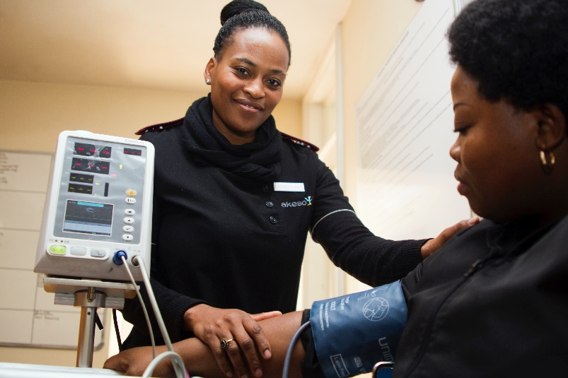
Examine your data to understand your ranks
Discussion & Reflection
Where is your county performing well?
For which measures does your county have room to improve?
Photo by Hush Naidoo on Unsplash
Notes:
Next, let’s examine the data to find some context for your county’s ranks. A good way to begin is to compare your county’s value to the state or top U.S. performers.
Identify two measures where your county seems to be performing particularly well:
Identify two measures where your county has room to improve:
Notice that the different types of quantitative data you reviewed in Section 2.1 are displayed in the snapshot.
Audience Prompt: Find a measure that uses each of the following types of data:
Percentages
Rates
Means
Medians
There are also ratios, which we did not discuss above. Provider ratios in the County Health Rankings indicate the number of residents served by 1 one provider if everyone in the county was distributed evenly. Example: (provide an example in a sentence)

Slide 34
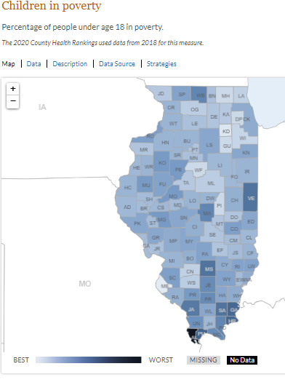
Dig Deeper into the data
Exploring Disaggregated Data
Exploring Measure Details
Notes:
Here are several ways you can dig deeper into your data:
Disaggregated Data—It’s important to investigate data by other subgroups. Where possible, we provide our measures broken down by race and ethnicity. Find this data by clicking the measure value if it appears blue and underlined in the snapshot.
Measure Details—Click on any measure name to explore Measure Details, including:
A map for that measure
Data for all counties in your state
Detailed description of the data including:
Reason for Ranking
Measure Methods
Details about using the measure to track progress
Notes about whether subgroup data is available for the measure
Data source
Policies related to the measure
Audience Prompt: Try it out!
Scroll to Children in Poverty under Social & Economic Factors.
Click on the value for your county.
Can you see the data broken down by race and ethnicity for your county?
How does Children in Poverty vary by race and ethnicity in your county?
Now click on the measure name to explore the measure details.
What type of data are used for this measure?
What is the data source?
It’s important to ask questions about the measures in your snapshot to make sense of your data. Understanding how data are collected and displayed is important for deciding if the data can serve your purposes.

Slide 35
Discussion & Reflection
What about your County Health Rankings snapshot surprised you?
What questions does your snapshot raise for you about what's impacting health in your community?
Notes:
Note to facilitator: The slide is animated and questions will appear one at a time. These discussion prompts are great for group discussion and can also be completed on the individual worksheet. Starting the participants with individual reflection and then group reflection will reinforce learning.

Slide 36
Key Takeaways
Understanding how data are collected and displayed is important for deciding if data can serve your purposes.
The County Health Rankings snapshot provides more than 30 measures of county-level data.
Notes:
Note to facilitator: This slide is meant to be a learning check on the “Interpret county snapshots from County Health Rankings & Roadmaps” learning objective.
The slide is animated and key takeaways will appear one at a time. These points are great moment for group reflection before moving on to the next content section.

Slide 37
Congratulations!
Now that you have explored this content, you should be able to:
Define data.
Understand the difference between qualitative and quantitative data.
​​​​​​​​​​​​​​Differentiate between quantitative and qualitative methods of measuring the health of populations.
Describe different methods for measuring the health of a population.
Interpret county snapshots from County Health Rankings & Roadmaps.
Examine common sources of community health data.
Notes:
Note to facilitator: Thank you for using this guide to lead your group or coalition through learning about how to use data to drive action. If you have any questions or feedback, please reach out at https://www.countyhealthrankings.org/about-us/contact-us

Slide 38
Contact Us
We would love to hear your thoughts on this presentation or to discuss any questions you have!
Contact us
Notes:
Action Learning Coaches are available around the country to answer your questions and discuss data applications in your community. Click the “Contact us” in this presentation, or at our website (www.countyhealthrankings.org/about-us/contact-us) to reach us.

