Slide 1
Notes for facilitator
See slide notes
Notes:
Notes for facilitator: This slide is hidden and will not present in “Slide Show” mode.
This facilitation guide and associated slides are intended to support group facilitation of the Understand and Identify Root Causes of Inequities Action Learning Guide content from the County Health Rankings & Roadmaps program.
The slides are grouped into content sections with headers that begin with numbers. These sections may be helpful if you intend to facilitate the content over multiple sessions. If you decide to facilitate the content in sections, we recommend returning to and reviewing Section 1.0 “Ground Setting” before each session.
You may use the notes sections on each slide as a script which may be read aloud or adapted to your preferred way of speaking. Please feel encouraged to include examples, stories, context, or local data that help your audience/participants meet their objectives and needs.
Before beginning, we recommend each learner receive the companion worksheet to the Action Learning Guide. You may encourage everyone to utilize the worksheet digitally (https://www.countyhealthrankings.org/sites/default/files/UnderstandandIdentifyRootCauses_Worksheet.pdf) or by providing printed copies.
Finally, please feel encouraged to reach out to County Health Rankings & Roadmaps if you have any questions about content or facilitation: https://www.countyhealthrankings.org/about-us/contact-us

Slide 2
Starting Questions
Are some people experiencing poorer health outcomes than others in the community?
What do you think are some of the causes of these differences in health outcomes?
Notes:
Note for facilitator: This slide is hidden and will not present in “Slide Show” mode.
Consider asking one or both of the slide questions before the beginning the presentation.

Slide 3
Understand and Identify Root Causes of Inequities
Slides for Group Facilitation
countyhealthrankings.org
Notes:
In healthy communities, everyone has opportunities to thrive. This means everyone having access to quality schools, good paying jobs, healthy foods, quality healthcare, affordable housing, and safe neighborhoods. However, in some communities, not everyone has access to these opportunities.
This learning guide focuses on understanding how inequities in communities impact health. While some of these issues are easy to see, others are less clear. These deeper, underlying factors are referred to as root causes.
Once you can identify these root causes that impact health, you can begin to develop strategies to address them so that everyone in the community has a fair and just opportunity for good health.

Slide 4
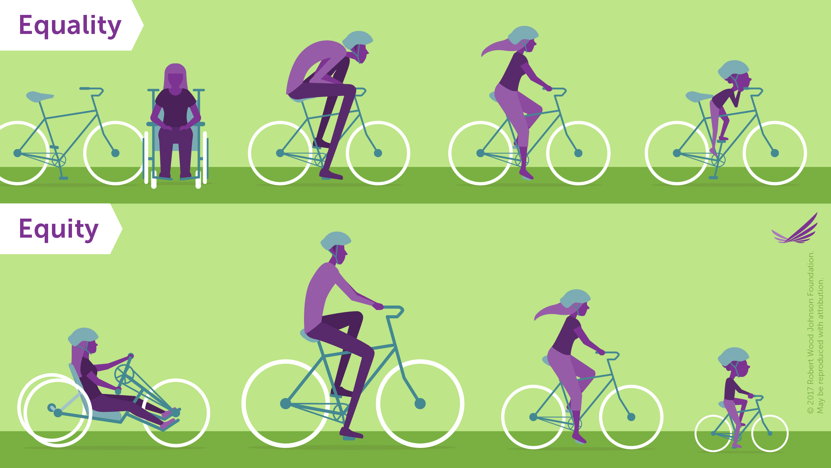
Terms and Definitions
Equity means that everyone has a fair and just opportunity to access what they need to thrive.
The goal of equality is to make sure that everyone has access to the same things to be healthy.
Notes:
Let’s start with a shared understanding of five terms that we will use throughout this guide.
Equity means that everyone has a fair and just opportunity to access what they need to thrive. This requires removing obstacles to health such as poverty, discrimination, and their consequences, including: powerlessness and lack of access to well-paying jobs, quality education and housing, safe environments, and health care.
The goal of equality is to make sure that everyone has access to the same things to be healthy.
Note for facilitator: Read definitions from slide and note that this slide is animated so the second definition of equality will appear when you advance/press enter.
Participant prompt: Based on these definitions and reflecting on the graphic, what is the difference between equity and equality?
Note for facilitator: Equality may mean that everyone receives the services or treatment, while equity takes into consideration that some people or groups may need different or tailored services in order to have equal opportunities.
Citation :
Braveman P, Arkin E, Orleans T, Proctor D, and Plough A. What Is Health Equity? And What Difference Does a Definition Make? Princeton, NJ: Robert Wood Johnson Foundation, 2017.

Slide 5
Terms and Definitions
Health disparities
Potentially concerning differences in health, particularly for groups at underlying or social disadvantage (e.g., race, ethnicity, or class).
Describe the problem or differences in health but not how those differences occurred.
Health inequity
Health disparity that is not only unfair but may also reflect injustice.
Examples
Poverty, discrimination, and their consequences
Powerlessness
Lack of access to well-paying jobs, quality education and housing, safe environments, and health care.
Notes:
Note for facilitator: Read definitions from slide and note that this slide is animated so the second definition of health inequity will appear when you advance/press enter.
Participant prompt: Based on these definitions, what is the difference between health disparities and health inequity?
Note for facilitator: Health inequities are unfair or unjust, while health disparities may or may not be due to unfair treatment or opportunities.
Citation:
Braveman P, Arkin E, Orleans T, Proctor D, and Plough A. What Is Health Equity? And What Difference Does a Definition Make? Princeton, NJ: Robert Wood Johnson Foundation, 2017.

Slide 6
Definitions
Root Causes
Underlying reasons that create differences seen in health outcomes.
Conditions in a community that determine whether people have access to the opportunities and resources they need to thrive.
The root cause of unequal allocation of power and resources creates unequal social, economic, and environmental conditions. Those conditions then lead to poorer health outcomes for some groups in a community.
Notes:
Note for facilitator: Read definition from slide.
Differences in things like obesity, infant mortality, and violence between groups in a community are health outcomes, not the underlying causes of the health inequities. It is important for us to understand what is causing differences in health outcomes so that we can work on the root causes and make long-lasting change.
Citations:
National Academies of Sciences, Engineering, and Medicine; Health and Medicine Division; Board on Population Health and Public Health Practice; Committee on Community-Based Solutions to Promote Health Equity in the United States; Baciu A, Negussie Y, Geller A, et al., editors. Communities in Action: Pathways to Health Equity. Washington (DC): National Academies Press (US); 2017 Jan 11. 3, The Root Causes of Health Inequity. Available from: https://www.ncbi.nlm.nih.gov/books/NBK425845/

Slide 7
Learning objectives
Define root causes of inequities that influence health.
Explain why root causes matter in community health improvement efforts.
Identify root causes of inequities that influence health.
Notes:
Note for facilitator: Review the learning objectives with your group and ask for reflections on items particularly pertinent to your community and/or places of strength/weakness that currently exist in your work.

Slide 8
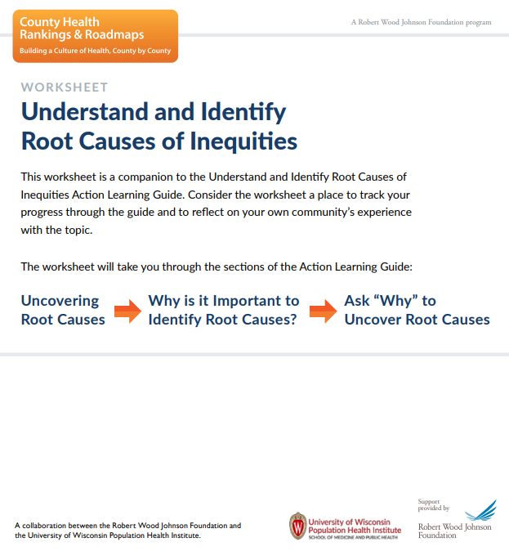
What you can expect
Learn from the content.
Learn from discussion and reflection.
Learn from taking action.
Notes:
Note for facilitator: This is a great time to introduce the companion worksheet to the Action Learning Guide. You may encourage everyone to utilize the worksheet digitally (https://www.countyhealthrankings.org/sites/default/files/UnderstandandIdentifyRootCauses_Worksheet.pdf ) or by providing printed copies.
As we go through this guide together, we will:
Learn from guidance, tools, and examples to help you develop a deeper understanding of underlying or root causes of inequities that influence health.
Have time to discuss and apply the learnings. Use the companion worksheet to capture your reflections and learnings.
Practice with tips and tools to help you put what you learn into action.

Slide 9
Uncovering Root Causes
Credit: Trevor Pye on Unsplash
Credit: Jeremy Bishop on Unsplash
Credit: Emma Gossett on Unsplash
Notes:
Participant prompt: Envision a healthy tree – how would you describe it?
Note for facilitator: Encourage participants to share descriptive words/terms by using prompts such as:
What do the branches look like?
Does it have leaves?
What do you think the tree looks like under ground?
What does the tree need to grow?

Slide 10
Uncovering Root Causes
Notes:
Consider this image. The leaves and branches—things we easily see—represent health outcomes. The roots of the tree determine how the tree grows and how much it thrives. They are the conditions in a community that determine whether people have access to the opportunities and resources they need to thrive.
In the tree on the right, we see unhealthy roots like poor quality schools, poverty, and environmental toxins. This has resulted in the poor health that is visible in its branches. The tree on the right cannot grow well if its roots are not cared for.
The tree on the left looks much healthier, with things like adequate income, quality housing, and a clean environment supporting better health outcomes.
But how do these differences in community conditions and health outcomes happen? Differences in opportunity are the result of unfair and discriminatory practices and policies at many levels throughout society that have created deep-rooted barriers to health.
Citation: Ramirez Brennan, L. K., Baker, E. A., & Metzler, M. (2008). Promoting Health Equity - A Resource to Help Communities Address Social Determinants of Health. Retrieved from https://www.cdc.gov/nccdphp/dch/programs/healthycommunitiesprogram/tools/pdf/SDOH-workbook.pdf

Slide 11
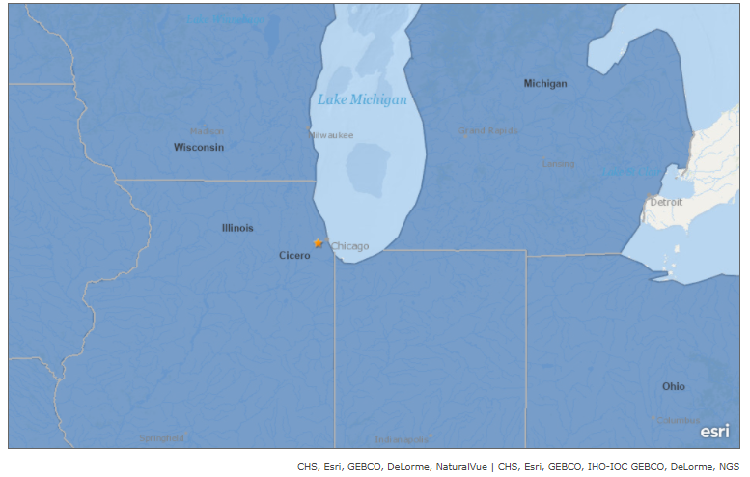
Cicero, IL: Uncovering Root Causes
Notes:
Let’s apply the tree example to a community.
Imagine living in a community where you don’t feel safe to go about daily activities like going to work, school, or the grocery store. The residents of Cicero, Illinois, a community just outside of Chicago, once felt this way.
In 2007, they held a community summit to begin to understand the root causes of the violence they were seeing in their neighborhoods. Residents and city government, police, and school representatives all participated, giving them an opportunity to understand their roles and the deeply rooted issues that contributed to the challenges Cicero faced.
For Cicero residents, identifying and understanding what was causing the pressing issues in their community was a first step in addressing them. These root causes included things like poverty, a lack of well-paying jobs, and young people feeling disconnected from family, community, or school.
Later in this guide, we will revisit the Cicero, Illinois example and learn more about how people came together to address community safety with collective action that resulted in health improvements.

Slide 12
Discrimination is a Root Cause
Discrimination:
Is a root cause of poor health outcomes.
Can lead to unfair treatment and unequal access to services.
May be unintentional.
Continues to occur when it becomes part of practices and policies.
class
race
ethnicity
immigration status
gender
sexual orientation
Notes:
In Cicero, community residents and leaders identified things like poverty, a lack of well-paying jobs, and young people feeling disconnected as root causes of violence in their community.
Participant prompt: What could be some deeper root causes of things like poverty, lack of jobs, and youth disconnectedness?
This type of discrimination may be related to things like class, race, ethnicity, immigration status, gender, or sexual orientation.
Discrimination is not always conscious, intentional, or personal, and yet it can become part of institutional practices and policies over time.
Institutions and organizations like businesses, government agencies, and schools influence access to healthy opportunities through their practices and policies. They are important to consider when thinking about root causes.
For example, city or county zoning laws often determine where supermarkets and other places that sell healthy foods can operate in a community. If these zoning laws prevent stores from opening, residents can be cut off from access to healthy food options. Business practices, such as hiring local residents, can also help to address root causes like unemployment and poverty, helping to improve health.

Slide 13
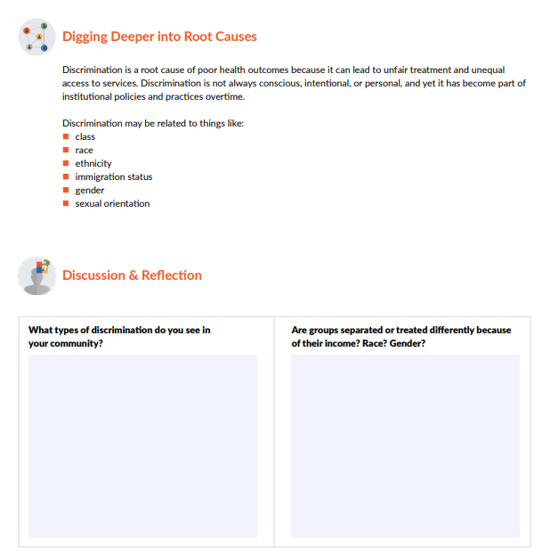
Discussion & Reflection
What types of discrimination do you see in your community?
Are groups separated or treated differently because of their income, race, and/or gender?
Notes:
Notes for facilitator:
This slide is meant to be a learning check on the “Define root causes of inequities that influence health” learning objective.
The slide is animated and questions will appear one at a time. These discussion prompts are great for group discussion and can also be completed by individuals on the worksheet.
Consider starting the participants with individual reflection and then group reflection will reinforce learning. You can do this by suggesting, “Take five minutes to write your own thoughts on the worksheet, then we’ll come together as a group to discuss this.”

Slide 14
Practices and Policies
Notes:
Let’s explore how root causes become deeply imbedded in practices and policies.
Imagine a family living in a neighborhood where there aren’t any grocery stores and healthy food options are limited. Streets may not be safe for walking or biking, and the only safe space for kids to play is across a busy highway. There’s a bus depot in the neighborhood that contributes to air pollution. This pollution contributes to a higher rate of asthma among the neighborhood’s school children. The buses that serve this neighborhood don’t run in the evenings or on weekends when most people who live here need to get to work. This makes getting to well-paying jobs difficult without owning a car —and many of the residents do not own one.
The conditions in this neighborhood didn’t happen by chance.
Over time, people in power made decisions and policies about food, land use, and transportation that cut off this neighborhood from resources. Those decisions and policies were followed within organizations and systems so that unfair practices became embedded with long-term impacts. They became root causes of the community conditions that I described.
This type of unfair decision-making impacts communities around the country, particularly communities of color and low-income communities. An example is redlining, which led to unfair banking and loan practices. It is a commonly referenced example of unfair and unjust policies with far-reaching, long-term impacts.
Note for facilitator: If the participants are interested in a fuller definition of redlining: Redlining is a policy rooted in structural racism. The term originates from past practices when mortgage lenders would draw red lines around portions of a map to show neighborhoods where they would deny loans for housing and businesses. While the most known examples of redlining have involved denial of financial services such as banking or insurance, other services such as health care or supermarkets have been denied to residents in some communities.
Citation: Federal Fair Lending Regulations and Statutes Fair Housing Act. (n.d.). Retrieved from https://www.federalreserve.gov/boarddocs/supmanual/cch/fair_lend_fhact.pdf

Slide 15
Discussion & Reflection
What conditions make a neighborhood in your community desirable to live in?
What makes a neighborhood undesirable?
What decisions led to those conditions?
Notes:
Notes for facilitator:
This slide is meant to be a learning check on the “Define root causes of inequities that influence health” learning objective. The slide is animated and questions will appear one at a time. These discussion prompts are great for group discussion and can also be completed on the individual worksheet.
Consider starting the participants with individual reflection and then group reflection will reinforce learning. You can do this by suggesting, “Take five minutes to write your own thoughts on the worksheet, then we’ll come together as a group to discuss this.”
Discuss as many ideas as time allows. Consider writing down some of the common responses to the questions which may be helpful to refer back to as you move through the guide.
Participant prompt: Think about your own community. Are there neighborhoods or areas of your community that are like this one where some have more access to opportunities than others?
What conditions make a neighborhood in your community desirable to live in?
What makes a neighborhood undesirable?
What decisions led to the difference in those neighborhood conditions?

Slide 16
Key Takeaways
Root causes are the underlying and sometimes long-standing reasons that there is poor health in a community.
Poor health outcomes are often symptoms of root causes.
Practices and policies of institutions are root causes that affect living conditions or opportunities that groups experience within the same community.
Unfair and discriminatory practices and policies are root of inequities.
Notes:
Notes to facilitator:
The slide is animated and key takeaways will appear one at a time. This is a great moment to clarify content as needed and for group reflection before moving on to the next content section.
This slide is meant to be a second learning check on the “Define root causes of inequities that influence health” learning objective.
Overarching concepts to reinforce include:
The root causes of inequities that influence health can be deep and long-standing based on the history of a community. But it is never too late to identify and address them.
If we fail to address the underlying causes of what influences health, we can’t build a healthy community. Despite our best intentions, inequities within the community will continue uninterrupted.

Slide 17
Why is it Important to Identify Root Causes?
Jones, C. P,, Jones, C.Y., Perry, G.S., & Barclay, G. (2009) Addressing the Social Determinants of Children’s Health: A Cliff Analogy. Journal of Health Care for the Poor and Underserved 20(4): 1-12.
Notes:
Now that we understand root causes of health inequities, why is it important to identify them?
This video about The Cliff of Good Health can help us understand why it is important to address root causes to achieve a healthy community. In this video, Dr. Camara Phyllis Jones explains that the drivers of good health go beyond our genes and our health behaviors. She uses the term social determinants of health – things we talked about like housing, education, and income – to describe the root causes of inequities. This video shows how differences in opportunity can lead to inequities.
Note for facilitator: Pause now and play the Cliff of Good Health video.
The video showed that sending an ambulance after someone who has already fallen off the cliff or placing a safety net halfway down the cliff are not as effective as preventing that person from getting too close to the cliff in the first place. In other words, people will keep getting injured or sick unless the root causes of what’s injuring or making them sick are addressed. In this analogy:
The ambulance represents services that support immediate needs in the community. Think about things like food pantries and emergency shelters.
The net and fence represent efforts to prevent major problems from arising in the future. Think about things like food assistance programs and housing vouchers.
Preventing people from getting pushed too closely to the edge of the cliff is the idea behind addressing root causes in communities where people live, work, and play. This would include addressing inequities like discrimination and unfair policies that are preventing some groups from things like accessing well-paying jobs and fair housing policies.
Citation: Jones, C. P,, Jones, C.Y., Perry, G.S., & Barclay, G. (2009) Addressing the Social Determinants of Children’s Health: A Cliff Analogy. Journal of Health Care for the Poor and Underserved 20(4): 1-12.

Slide 18
Key Takeaways
Inequities and poor health are likely to continue unless communities identify and address the root causes.
Identifying and addressing root causes helps ensure that conditions and policies in a community are fair and just, so everyone has the opportunity to live their healthiest life.
Notes:
Notes to facilitator:
The slide is animated and key takeaways will appear one at a time. This is a great moment to clarify content as needed and for group reflection before moving on to the next content section.
This slide is meant to be a second learning check on the “Explain why root causes matter in community health improvement efforts” learning objective.
Overarching concepts to reinforce include:
Inequities and poor health are likely to persist unless communities identify and address the root causes.
Identifying and addressing root causes helps to ensure that conditions and policies in a community are fair and just, so everyone in the community has the opportunity to live their healthiest life.

Slide 19
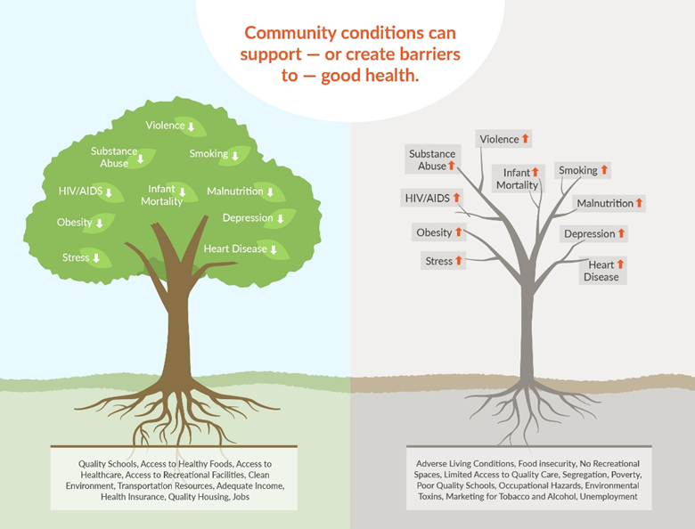
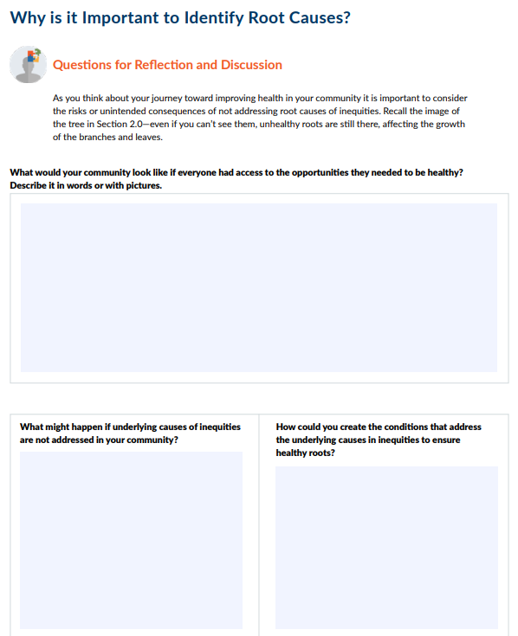
Discussion & Reflection
What would your community look like if everyone had access to the opportunities they need to be healthy?
What might happen if underlying causes of inequities are not addressed?
How could you create the conditions that address the underlying causes in inequities to ensure healthy roots?
Notes:
Notes to facilitator:
This slide is meant to be a learning check on the “Explain why root causes matter in community health improvement efforts” learning objective.
The slide is animated and questions will appear one at a time. These discussion prompts are great for group discussion and can also be completed on the individual worksheet.
Consider starting the participants with individual reflection and then group reflection will reinforce learning. You can do this by suggesting, “Take five minutes to write your own thoughts on the worksheet, then we’ll come together as a group to discuss this.”
You can encourage participants to use pictures to share their thoughts about the first question, “What would your community look like if everyone had access to the opportunities they need to be healthy?” To make it interactive, consider having participants draw their ideas on large pieces of paper and post them in your meeting space for everyone to view.
Earlier, we talked about how discrimination or unfair treatment may not intentional. As you think about your journey toward improving community health, it is important to consider the risks or unintended consequences of not addressing root causes of inequities. Recall the image of the tree we look at - if you can’t see them, unhealthy roots are still there, affecting the growth of the branches and leaves.

Slide 20
Ask “Why?” to Uncover Root Causes
Notes:
Now that we know what root causes of inequities are and why it is important to identify them, let’s look at how to begin to identify them in a community.
Note for facilitator: Pause now and play the Why is Jason in the Hospital? video.
As we saw in the video, Jason’s friend Andrés keeps asking “Why?” to uncover all the reasons that led to Jason’s injury. By doing so, he ultimately uncovers the root causes of Jason’s injury.
Asking a series of good questions is one way to find real answers.

Slide 21
Asking “Why?” to Uncover Root Causes
Notes:
Notes to facilitator: This slide is meant to be a guide for The “But, why?” Activity, for use with page 6 of the worksheet.
Group activity:
Consider making notes on large pieces of paper posted in the meeting space so everyone can view them as you go through the activity. Participants can take their own notes on the worksheet.
Select an existing health issue in the community (e.g., obesity, drug abuse, infant death). Tip: Practice first with a familiar or less complex problem, then progress to more complex issues.
Start by asking what caused health issue.
Each time an answer is given, continue asking “But, why?” or “How could that have been prevented?” in order to identify some of the root causes of the health issue.
After generating a few root causes of the health issue, pause for group reflection and discussion about the process/activity. Ask participants to share thoughts about when the “But, why?” technique might be useful to communities.
We practiced by addressing one community issue or problem as a group. You can repeat the “But, why?” process for other issues. You may even discover that some community problems have the same sources or root causes. A root cause that is related to more than one problem in the community may be one that your group decides needs to be addressed first.

Slide 22
Collaboration to Uncover Root Causes
Know about the people in your community and whose voices need to be part of the decision- and change-making processes.
Ensure that residents provide input and share in decision making.
Engage government and political leaders in your collaborations.
Consider the sectors that influence community health—education, business, housing, transportation, etc.
Notes:
Now that we’ve practiced using the “But, why?” process, let’s think about who needs to be part of the process in order to get a full and accurate picture of root causes behind a problem you are seeing in a community.
Communities are made up of people—people who live there, people who learn there, people who work there, people who play there--and everyone needs to be included in making decisions and changes when working to improve a community. This includes both the organizations working to support the community and the residents who live there. If anyone is left out, a complete picture of a community is not seen. Think back to the example from Cicero, Illinois (Section 2.1)—they sought input from people representing multiple sectors, including local government, law enforcement, and schools, as well as residents, to understand the problem and identify solutions.
Engaging everyone in the “But, why?” activity will provide you with a more complete view of the root causes of inequities that influence health in a community. It can also help you uncover multiple solutions for a problem or solutions that one person may have not seen before.
Note for facilitator: The slide is animated and each bulleted item will appear one at a time as you advance/press enter and go over each tip.
Here are some tips to help you identify who needs to be part of your collaborative effort to identify and address root causes of inequities:
Learn more about the people in your community so you know whose voices need to be part of the decision- and change-making processes.
Ensure that residents provide input and share in decision making.
Think about the areas where decisions and policies are made for your community. Engage government and political leaders in your collaborations.
Consider the sectors that influence community health—education, business, housing, transportation, etc.—and include people from as many of these sectors as you can.
Participant prompt: Think about your own community. Who should be asked to participate in uncovering root causes of health inequities?
Note for facilitator: Pause here and ask participants to brainstorm as a group or individually.

Slide 23
Cicero, IL: A Path Toward Better health
Notes:
Identifying root causes of inequities that influence health takes commitment and time, but it is doable! At the beginning of this guide (Section 2.1), you learned about Cicero, Illinois, and their efforts to create a safer community. They started by first bringing together people who were affected by the problem and people who traditionally had a role in the solutions to understand what was going on and why. Then they began working together to address a few of the root causes they had identified.
Notes for facilitator:
This slide revisits the Cicero, Illinois community example to show how the concepts and approaches in this guide can be implemented to understand and identify root causes of health inequities. Options for facilitating include:
View the 10-minute video together as a group, if time allows.
View some or all of the following highlights in the video:
See how town leaders, police, and community partners came together to address safety — 00:54-2:01.
Hear how addressing trauma early on as a root cause led to broad positive impacts in Cicero — 02:02-2:55.
Find out more about Cicero’s Parent Patrol and their role in addressing gang-related violence — 02:56-03:46.
Or, you may read through the script below, and give participants the link to the video (https://youtu.be/YHSzzkNbmrM) and encourage them to view it on their own.
Town leaders and police focused on how they could address gang-related violence—a concern raised at the community summit. As a result, the police department changed their entire culture, according to Commander Vincent Acevez. They began working with therapists in the community to train all officers on how to better interact with people who have been exposed to trauma or repeated stress.
Recognizing their role in addressing the underlying causes, residents created the Parent Patrol. Now, parent volunteers stand on street corners to keep kids safe before and after school. These activities led to step-by-step improvements and a united path toward a safer community and better community health.
Gangs have not disappeared, but the town has successfully reduced the level of street violence. In 2017, Cicero had seven gang-related shootings and one homicide, a dramatic improvement over years past.
The community partners in Cicero started working together to address community safety. Now, they continue to identify and address other root causes as they strive toward better health for all.
Cicero’s inspirational story shows what’s possible when communities focus on the sources or root causes of inequities.

Slide 24
Key Takeaways
To identify root causes, start with the issue that is easily seen.
Then continue to ask, “But, why?” to uncover the conditions, practices and policies that are causing them.
Engage community residents, partners and other stakeholders who can provide a full picture of the issue.
Uncovering root causes is an important step in making long-lasting community health improvements.
Notes:
Notes for facilitator:
The slide is animated and key takeaways will appear one at a time. This is a great moment to clarify content as needed and for group reflection before moving on to the next content section.
This slide is meant to be a learning check on the “Identify root causes of inequities that influence health” learning objective.
Overarching concepts to reinforce include:
To identify root causes, start with the issue or outcome you readily see, then continue to ask, “But, why?” to uncover the conditions and practices and policies that are causing them.
It takes a group of community residents and partners—each with unique and valuable experiences—to clearly identify the root causes of inequities that influence health.
Identifying root causes of inequities can lead to improvements in community health.

Slide 25
Congratulations!
You have completed the Understand and Identify Root Causes of Inequities guide, and can:
Define root causes of inequities that influence health.
Explain why root causes matter in community health improvement efforts.
Identify root causes of inequities that influence health.
Notes:
Now that we have completed the Understand and Identify Root Causes of Inequities guide together, you should be able to:
Define root causes of inequities that influence health.
Explain why root causes matter in community health improvement efforts.
Identify root causes of inequities that influence health.
Congratulations and thank you for your efforts to improve community health!

Slide 26
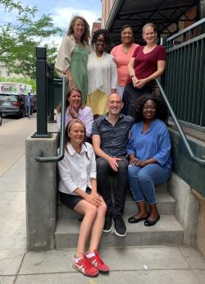
Contact Us
We would love to hear your thoughts on this guide or to discuss any questions you have!
Contact us
Notes:
Click the “Contact us” text in this presentation, or at our website (https://www.countyhealthrankings.org/about-us/contact-us) to reach us.
Note for facilitator: Thank you for using this guide to lead your group or coalition through learning about how to understand and identify root causes of health inequities. If you have any questions or feedback, please reach out at https://www.countyhealthrankings.org/about-us/contact-us

