Slide 1
Notes for facilitator
See slide notes
Notes:
Note to facilitator: This slide is hidden and will not present in “Slide Show” mode.
This facilitation guide and associated slides are intended to support group facilitation of the Introduction to Equity Action Learning Guide content from the County Health Rankings & Roadmaps program.
The slides are grouped into content sections with headers that begin with numbers. These sections may be helpful if you intend to facilitate the content over multiple sessions. If you decide to facilitate the content in sections, we recommend returning to and reviewing Section 1.0 “Ground Setting” before each session.
You may use the notes sections on each slide as a script which may be read aloud or adapted to your preferred way of speaking. Please feel encouraged to include examples, stories, context, or local data that help your audience meet their objectives and needs.
Before beginning, we recommend each learner receive the companion worksheet to the Action Learning Guide. You may encourage everyone to utilize the worksheet digitally (https://www.countyhealthrankings.org/sites/default/files/media/document/resources/Introduction_to_Equity_Worksheet.pdf) or by providing printed copies.
Finally, please feel encouraged to reach out to County Health Rankings & Roadmaps if you have any questions about content or facilitation: https://www.countyhealthrankings.org/about-us/contact-us

Slide 2
Starting Questions
What do you think is the difference between equality and equity?
Why does focusing on equality and/or equity feel important to you?
Are there inequities in health in (y)our community? What are they?
Notes:
Note to facilitator: This slide is hidden and will not present in “Slide Show” mode.
Consider asking one or both of the slide questions before the beginning the presentation.

Slide 3
Introduction to Equity
Slides for Group Facilitation
countyhealthrankings.org
Notes:
Imagine a community where everyone has the chance to thrive –with high quality schools, good paying jobs, and affordable housing in safe neighborhoods. Imagine a community where differences in race, income, gender, ability, and perspectives are celebrated. Imagine a community where we could all experience this, regardless of where we live, the circumstances we were born into, or who we are.
If this vision were achieved, everyone would have a fair and just opportunity to live their healthiest lives.
We know this is not yet the reality for everyone. Differences in opportunity are the result of unfair and discriminatory policies and practices at many levels throughout society that have created deep-rooted barriers to health. Far too many people in our communities start behind and stay behind because of where we live, how much money we make, or discrimination we face because of who we are.
The guidance, tools, and activities here will help you understand and talk about equity, which affects residents in every community, especially people experiencing poor health outcomes. It will help you get started with understanding what equity is, why it matters, and how it relates to health.
This is the right place if you:
Want to learn about what equity is and how to talk about barriers to opportunity in your community.
Want more information on why equity matters to health.
Are looking for guidance, tools, and examples to help you get started.

Slide 4
Learning objectives
Define and differentiate terms such as equality, equity, and inequity.
Describe why equity is important in a broad context.
Connect why equity matters to improving health outcomes.
Notes:
Note to facilitator: Review the learning objectives with your group and ask for reflections on items particularly pertinent to your community and/or places of strength/weakness that currently exist in your work.

Slide 5
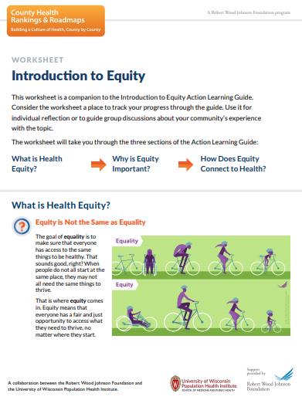
What you can expect
Learn from the content provided here.
Learn from discussion and reflection.
Reflect and capture your key takeaways.
Learn from action.
Notes:
Note to facilitator: This is a great time to introduce the companion worksheet to the Action Learning Guide. You may encourage everyone to utilize the worksheet digitally (https://www.countyhealthrankings.org/sites/default/files/media/document/resources/Introduction_to_Equity_Worksheet.pdf) or by providing printed copies.
_____________________________________________
Learn from the content provided here. The guidance, tools, and examples included here will help you develop a deeper understanding of what equity is and why it matters to health.
Learn from discussion and reflection. You will find discussion questions throughout to help you and your partners apply the learning as you go.
Reflect and capture your key takeaways. For example, you may want to note where you see equity and/or inequities in your community.
Learn from action. The tips and tools in this guide will help you put what you learn into action.

Slide 6
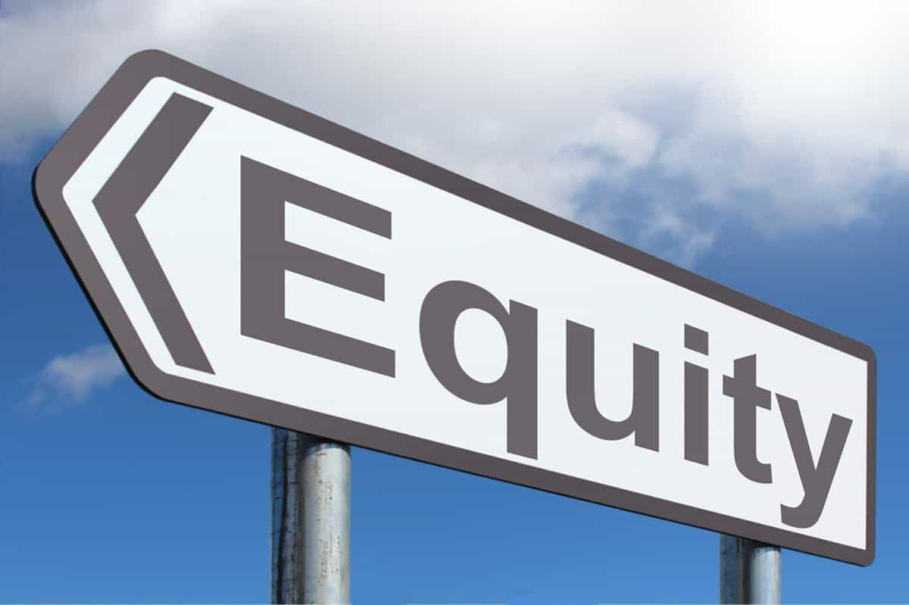
What is Equity?
What is equity?
How is it different from equality?
How is equity related to health?
This Photo by Unknown Author is licensed under CC BY-NC
Notes:
If you are working to improve the health of people living in your community, you might be hearing the word equity a lot. But what is equity? How is it different from equality? And how is it related to health?

Slide 7
What is Equity?
The goal of equality is to make sure that everyone has access to the same things to be healthy.
Equity means that everyone has a fair and just opportunity to access what they need to thrive
Notes:
The goal of equality is to make sure that everyone has access to the same things to be healthy. That sounds good, right? But people are diverse, with unique strengths and needs. And, they do not all start at the same place; they may face barriers or obstacles to health.
That’s where equity comes in. Equity means that everyone has a fair and just opportunity to access what they need to thrive. Equity means unfair obstacles are removed to help everyone thrive.

Slide 8
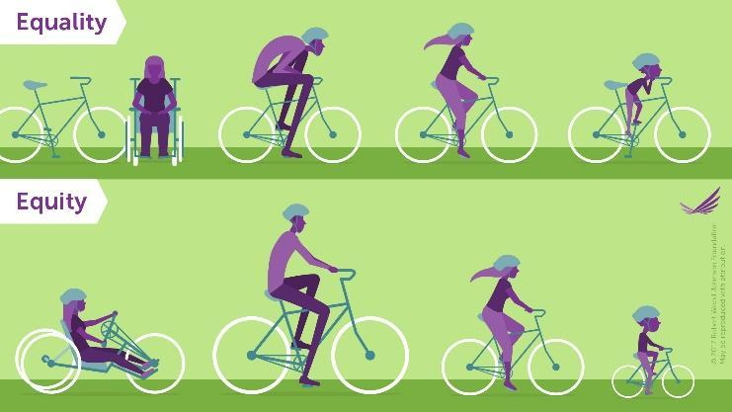
Equity is Not the Same as Equality
Notes:
This graphic illustrates the difference between equality and equity.
Audience Prompt: What are the images on the equality line telling us? What is different about the equity line?
Yes, in the approach to equality, everyone has the same size bicycle, even if it does not fit their needs. In the approach to equity, everyone has a bicycle, but the type is based on what they need for their circumstances. The standard one-size-fits-all bike doesn’t work for everyone.
Inequities result when there is a lack of opportunity and resources to thrive. These are conditions and obstacles that are avoidable and unfair.
Audience Prompt: As you take a moment to reflect on this graphic and the descriptions of equality and equity, what parts remind you of your experience as an individual? What parts remind you of your community?

Slide 9
Equity Applies to Individuals and Communities
Notes:
Equity doesn’t just apply to individuals, but also to communities and the groups of people who live there.
For example, in neighborhoods that have no public transportation or grocery stores nearby, it can be more difficult for residents to get to work or eat healthy foods. A neighborhood across town might have multiple bus lines and many grocery stores, which means residents have more choices for how to get to work and where to buy food.
Looking at these differences through an equity lens can help us understand the barriers to opportunity and good health that some residents face and help us identify ways we can work together to create conditions where everyone can live their healthiest lives.
The choices people make depend on the choices they have. Focusing on equity in communities means looking at what opportunities have been available—or not available—to neighborhoods and groups of people over time and how that has affected their health and well-being.
Audience Prompt:
As you think about your own community, how do opportunities differ between neighborhoods or groups of people?
What do you think has contributed to those differences?
What could be done to change them?

Slide 10
Key Takeaways
Equality and Equity are not the same.
Equality means everyone has or gets access to the same resource.
Equity means everyone has a fair and just opportunity to access what they need to thrive.
Inequities are the result of barriers that limit access to opportunity.
Equity applies to individuals and to groups of people living in communities.
Equity can be understood by thinking about how it applies to individuals and groups of people and the places where access, resources, and conditions may differ.
Photo by Austin Distel on Unsplash
Notes:
Note to facilitator: The slide is animated and key takeaways will appear one at a time. These points are great moment for group reflection before moving on to the next content section.
This slide is meant to be a learning check on the “Recognize the role of data in assessing community needs and assets & the Describe how data can be used to measure changes in health over time” learning objectives.

Slide 11
Discussion & Reflection
What were your “light bulb moments” in learning more about the difference between equality and equity?
What new perspectives have emerged?
Notes:
Note to facilitator: This slide is meant to be a learning check on the “Define and differentiate terms such as equality, equity, and inequity & Describe why equity is important in a broad context” learning objectives.
The slide is animated and questions will appear one at a time. These discussion prompts are great for group discussion and can also be completed on the individual worksheet.
Consider starting the participants with individual reflection and then group reflection will reinforce learning. You can do this by suggesting, “Take five minutes to write your own thoughts on the worksheet, then we’ll come together as a group to discuss this.”

Slide 12
Addressing Equity can Benefit Everyone
Notes:
Envision a place where everyone has a fair chance to lead the healthiest life possible regardless of where we live or the circumstances we were born into; this is the prospect of equity.
However, this is not always our reality. More often the choices we make depend on the opportunities we have, such as access to a quality education, healthy foods, and safe, affordable housing in crime-free neighborhoods. These opportunities are not the same for everyone.
Listen to Glenn Harris of Race Forward connect equity to a common predicament most of us have experienced at a public event, like a concert or a sporting event, and describe how to think about equitable solutions.
Note to Facilitator: Play the video now.
Audience Prompt:
How do Glenn Harris's ideas on equity, sampled above, resonate with your experience?
Consider your own community. What systems are out of balance?

Slide 13
Differences in Opportunity Affect Community Residents
Education Funding | School funding based on property taxes can mean low-income municipalities don’t have enough funds to support high-quality schools.
Safe and healthy housing | Poor quality housing can expose residents to allergens, lead, infectious diseases, and other hazards.
Healthy foods | Neighborhoods with limited access to healthy foods have higher rates of obesity and chronic diseases.
Parks and recreation | Unsafe neighborhoods or those without sidewalks and parks mean residents have fewer opportunities to be active.
Clean air and water | Proximity to highways and factories may expose residents to poor air quality or contaminated water. This can lead to asthma, birth defects, or premature birth.
Public transportation | Local transit options can support active, energy-efficient travel. Without these options, residents may not be able to access good jobs, health care, child care, or social services.
Notes:
Differences in opportunity do not come about on their own or because of the actions of individuals alone. Often, they are the result of policies and practices at many levels that have created deep-rooted barriers, such as unfair bank lending practices, school funding based on local property taxes, exclusionary zoning laws, and discriminatory policing and prison sentencing.
To create thriving communities, everyone needs access to goods, services, and opportunities to participate. We are more likely to make healthy choices if healthy options are available.
On the screen are examples of common ways in which barriers to opportunity affect communities and residents.
Audience Prompt: Which barriers to opportunity are present in our community?

Slide 14
Key Takeaways
Improving opportunity for some groups can have benefits for everyone in a community.
Differences in opportunity affect the choices we have to be healthy.
Policies and practices have created deep-rooted barriers to opportunity for individuals and groups of people.
Notes:
Note to facilitator: The slide is animated and key takeaways will appear one at a time. These points are great moment for group reflection before moving on to the next content section.

Slide 15
Discussion & Reflection
What surprised you about the ways barriers to opportunity affect communities and residents?
What questions did this section prompt for you?
Notes:
Note to facilitator: This slide is meant to be a learning check on the “Describe why equity is important in a broad context. & Connect why equity matters to improving health outcomes.” learning objectives.
The slide is animated and questions will appear one at a time. These discussion prompts are great for group discussion and can also be completed on the individual worksheet.
Consider starting the participants with individual reflection and then group reflection will reinforce learning. You can do this by suggesting, “Take five minutes to write your own thoughts on the worksheet, then we’ll come together as a group to discuss this.”

Slide 16
Gaps in Health Outcomes
The percentage of Black babies born at low birthweight is higher than all other racial groups in nearly every state in the nation.
Child poverty remains at higher levels than before the 2008 recession and has been slower to rebound in rural counties. Within counties, poverty rates among Black and Hispanic children are consistently higher than among White children.
In places with higher levels of segregation, Black children face greater barriers to opportunity and significantly worse health outcomes.
Notes:
Health is more than what happens in our doctor’s office; it is influenced by the places where we live, learn, work, and play. Our ability to live long, healthy lives is related to the access we have to things like affordable housing, quality schools, safe places for physical activity, and social connections with others. For groups that do not have access to these opportunities, we see meaningful gaps in health outcomes.
Gaps in Health Outcomes
The 2018 County Health Rankings Key Findings Report included analyses that show:
Low birthweight is a key measure of health and quality of life. The percentage of Black babies born at low birthweight is higher than all other racial groups in nearly every state in the nation.
Measuring child poverty is a way to assess both current and future health risks. Child poverty remains at higher levels than before the 2008 recession and has been slower to rebound in rural counties. Within counties, poverty rates among Black and Hispanic children are consistently higher than among White children.
Decades of research have shown how residential segregation of Blacks and Whites has perpetuated heath gaps in the United States. In places with higher levels of segregation, Black children face greater barriers to opportunity and significantly worse health outcomes.
Unfair policies and practices can make it harder for some people to access things like quality prenatal care, living wage jobs, and safe and affordable housing. This results in health gaps.
Consider how easy or how hard it is for people in your community to access opportunities based on where they live, how much money they make, or the color of their skin. Recognizing these differences is a first step in being able to close gaps.

Slide 17
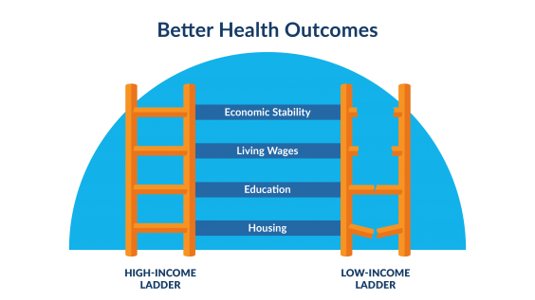
Focus on Equity to Improve Health Outcomes
Health disparities
Meaningful differences in health
Health equity
The principle or value that motivates us to eliminate health disparities
Notes:
Some people live shorter and less healthy lives. Data about groups and communities can show us where there are meaningful differences in health—or health disparities. Health disparities are identified when we see worse health in marginalized or excluded groups, compared to groups who have more opportunities for health.
Note to Facilitator: Point to Image
Disparities emerge when some groups benefit from consistently better access to opportunities and resources over a lifetime and across generations. For example, when children live in families with higher incomes, they typically experience stable housing in safer neighborhoods, have access to better-resourced and higher-quality schools, and are better prepared for living-wage jobs. When children live in families with lower incomes and do not have access to opportunities, they face challenges to gaining a foothold on the ladder to economic security and better health that helps them thrive.
Over time, we can track health gaps and the conditions that drive them to determine which to address and to measure our progress.
Health equity is the principle or value that motivates us to eliminate health disparities (Braveman, 2017). Including a focus on equity in your community helps people understand what gaps are avoidable and how to make sure all residents have the opportunity to live their healthiest lives. Acting to improve health and equity includes engaging with people who bring diverse experiences and voices that can deepen your understanding of what impacts health in your community

Slide 18
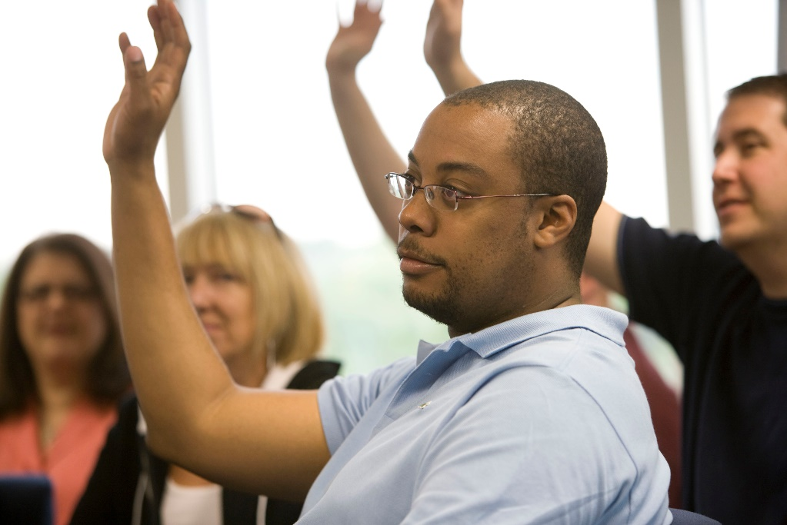
Key Takeaways
Health is influenced by the conditions in the places where we live, learn, work, and play.
Differences in access to opportunities that shape health can create disparities between groups of people in the community.
A focus on equity is important to improving health for everyone in your community.
Notes:
Note to facilitator: This slide is meant to be a learning check on the “Describe why equity is important in a broad context & Connect why equity matters to improving health outcomes.” learning objectives.
The slide is animated and key takeaways will appear one at a time. These points are great moment for group reflection before moving on to the next content section.

Slide 19
Discussion & Reflection
Reflect on your own community and its history, assets, and resources.
What are the social, economic, and physical conditions in your own community that help you be healthy?
Who has access to those opportunities and who does not?
What kinds of health gaps have you seen in your community?
What might motivate you and others in your community to focus on equity to improve health?
What resources, including conversations with people experiencing poor health, can help you learn more about gaps in health and opportunity in your community?
Notes:
Note to facilitator: This slide is meant to be a learning check on the “Describe why equity is important in a broad context. & Connect why equity matters to improving health outcomes.” learning objectives.
The slide is animated and questions will appear one at a time. These discussion prompts are great for group discussion and can also be completed on the individual worksheet.
Consider starting the participants with individual reflection and then group reflection will reinforce learning. You can do this by suggesting, “Take five minutes to write your own thoughts on the worksheet, then we’ll come together as a group to discuss this.”

Slide 20
Congratulations!
Now that you have explored this content, you should be able to:
Define and differentiate terms such as equality, equity, and inequity.
Describe why equity is important in a broad context.
Connect why equity matters to improving health outcomes.
Notes:
Note to facilitator: Thank you for using this guide to lead your group or coalition through learning about how to use data to drive action. If you have any questions or feedback, please reach out at https://www.countyhealthrankings.org/about-us/contact-us

Slide 21
Contact Us
We would love to hear your thoughts on this presentation or to discuss any questions you have!
Contact us
Notes:
Click the “Contact us” in this presentation, or at our website (www.countyhealthrankings.org/about-us/contact-us) to reach us.

