Slide 1
Notes for facilitator
See slide notes
Notes:
Notes for facilitator: This slide is hidden and will not present in “Slide Show” mode.
This facilitation guide and associated slides are intended to support group facilitation of the Develop Strategies to Promote Health and Equity Action Learning Guide content from the County Health Rankings & Roadmaps program.
The slides are grouped into content sections with headers that begin with numbers. These sections may be helpful if you intend to facilitate the content over multiple sessions. If you decide to facilitate the content in sections, we recommend returning to and reviewing Section 1.0 “Ground Setting” before each session.
You may use the notes sections on each slide as a script which may be read aloud or adapted to your preferred way of speaking. Please feel encouraged to include examples, stories, context, or local data that help your audience/participants meet their objectives and needs.
Before beginning, we recommend each learner receive the companion worksheet to the Action Learning Guide. You may encourage everyone to utilize the worksheet digitally (https://www.countyhealthrankings.org/sites/default/files/media/document/chrr_developingstrategiesequity_worksheet.pdf) or by providing printed copies.
Also note that the What Works for Health Activity (slides 20-24) will require access to computer(s) and the internet.
Finally, please feel encouraged to reach out to County Health Rankings & Roadmaps if you have any questions about content or facilitation: https://www.countyhealthrankings.org/about-us/contact-us

Slide 2
Starting Questions
What things do you and your partners typically do to get ready to implement strategies in your community?
Who do you usually engage in this process?
Who do you wish you could engage more in the process?
Notes:
Note for facilitator: This slide is hidden and will not present in “Slide Show” mode.
Consider asking one or both of the slide questions before the beginning the presentation.

Slide 3
Develop Strategies to Promote Health and Equity
Slides for Group Facilitation
countyhealthrankings.org
Notes:
In healthy communities, everyone has opportunities to thrive. This means everyone having access to quality schools, good paying jobs, healthy foods, quality healthcare, affordable housing, and safe neighborhoods. However, in some communities, not everyone has access to these opportunities.
The Understand and Identify Root Causes of Inequities Action Learning Guide (https://www.countyhealthrankings.org/take-action-to-improve-health/learning-guides/understand-and-identify-root-causes-of-inequities#/) is a place to start uncovering underlying causes of inequitable access to healthy opportunities in a community. Once you understand the root causes of inequities in a community, you can begin to develop strategies to promote health and equity so everyone has a fair and just opportunity for good health. This guide will help you do that.

Slide 4
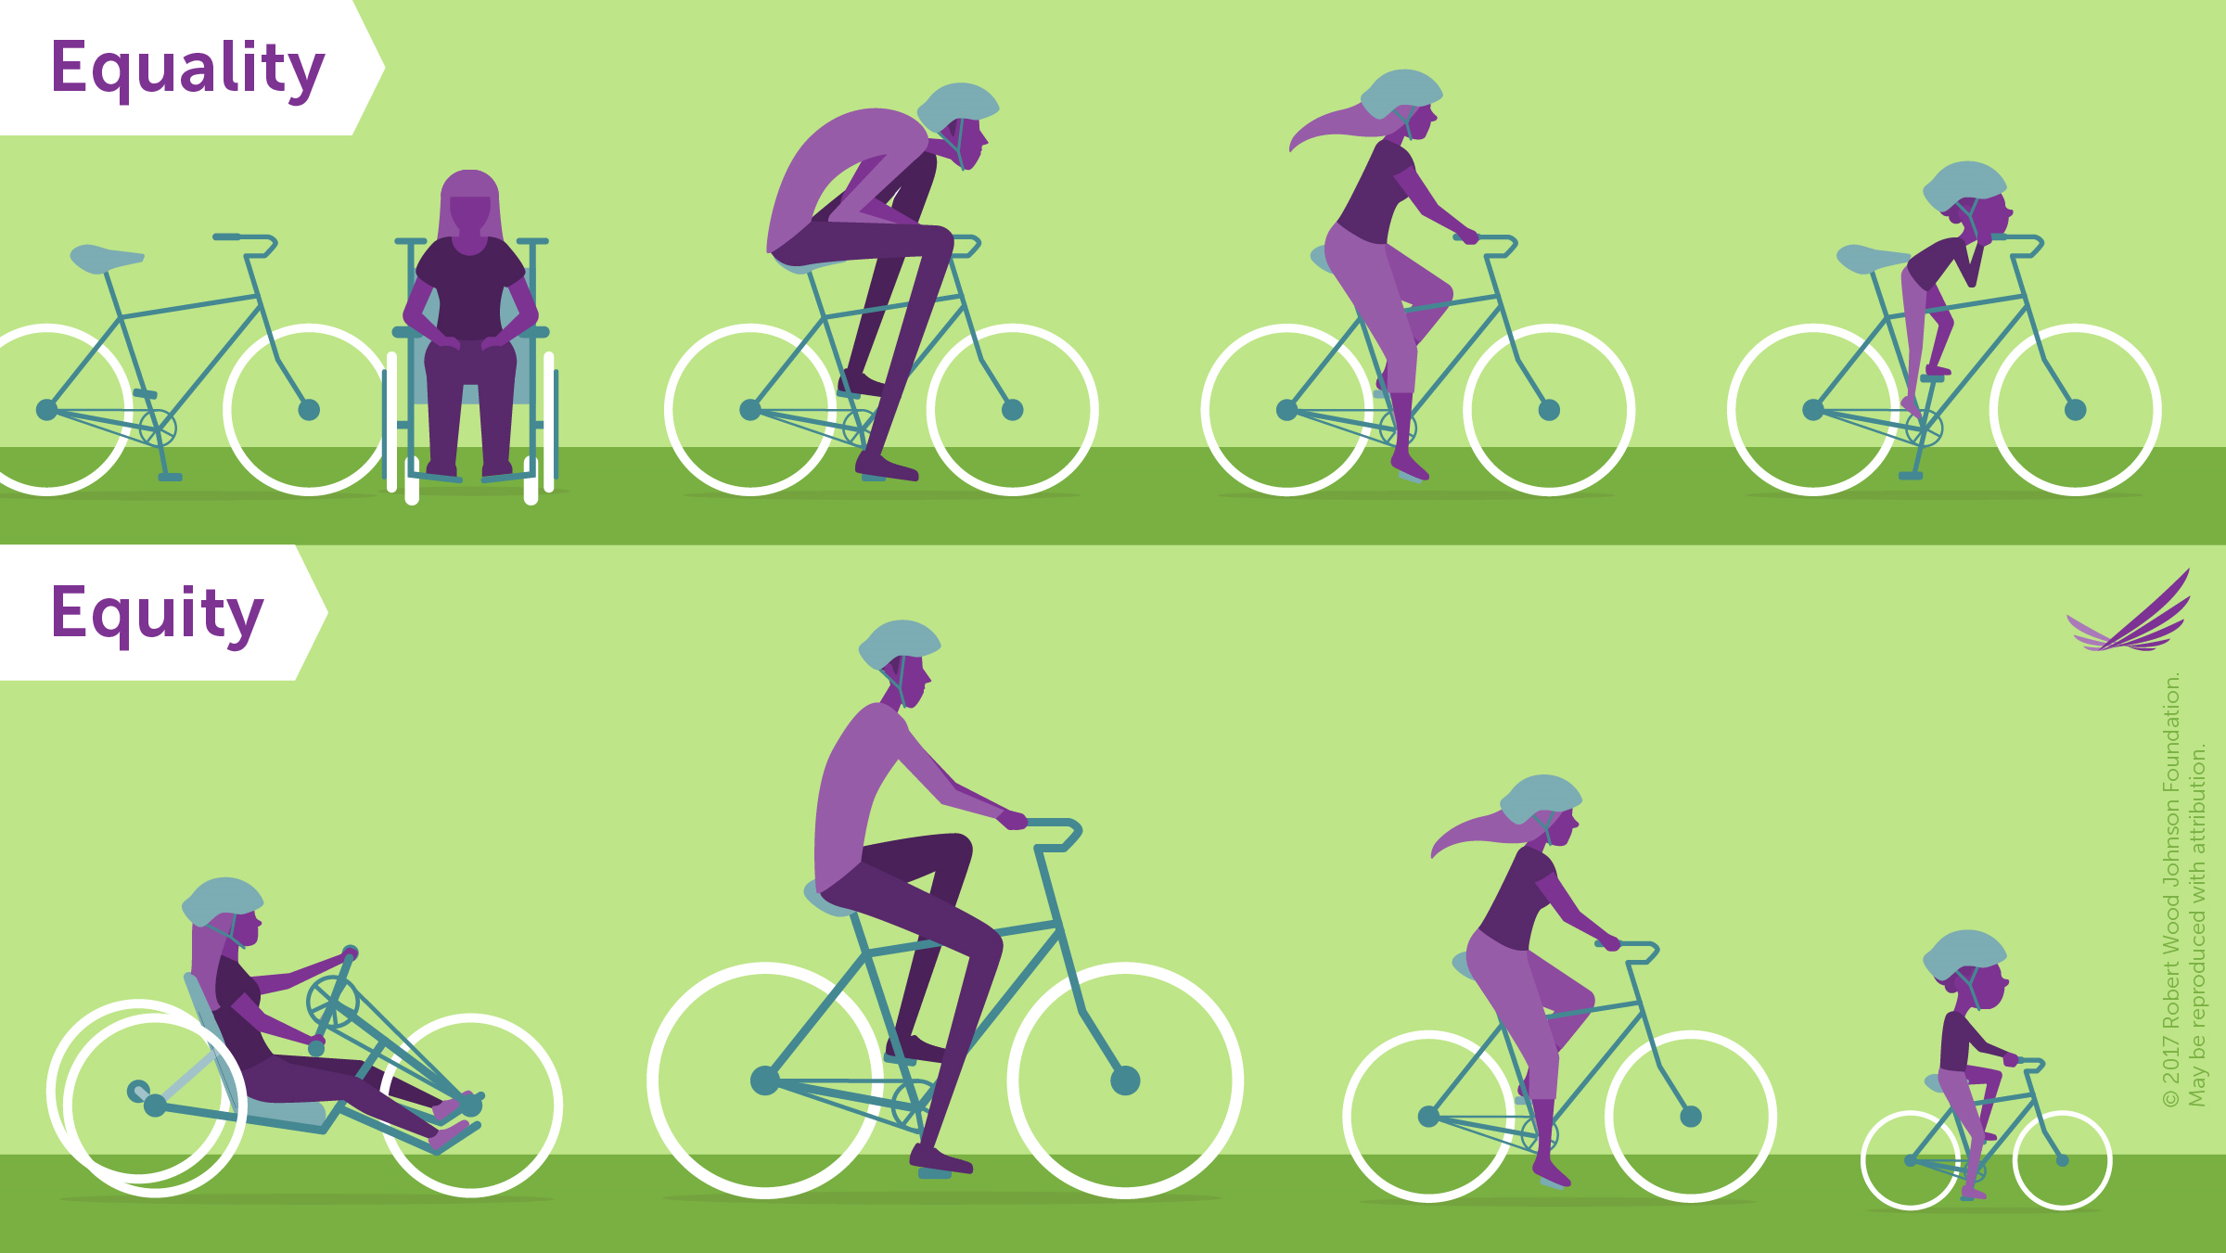
Terms and Definitions
Equity means that everyone has a fair and just opportunity to access what they need to thrive.
The goal of equality is to make sure that everyone has access to the same things to be healthy.
Notes:
Let’s start with a shared understanding of five terms that we will use throughout this guide.
Equity means that everyone has a fair and just opportunity to access what they need to thrive. This requires removing obstacles to health such as poverty, discrimination, and their consequences, including: powerlessness and lack of access to well-paying jobs, quality education and housing, safe environments, and health care.
The goal of equality is to make sure that everyone has access to the same things to be healthy.
Note for facilitator: Read definitions from slide and note that this slide is animated so the second definition of equality will appear when you advance/press enter.
Participant prompt: Based on these definitions and reflecting on the graphic, what is the difference between equity and equality?
Note for facilitator: Equality may mean that everyone receives the services or treatment, while equity takes into consideration that some people or groups may need different or tailored services in order to have equal opportunities.
Citation :
Braveman P, Arkin E, Orleans T, Proctor D, and Plough A. What Is Health Equity? And What Difference Does a Definition Make? Princeton, NJ: Robert Wood Johnson Foundation, 2017.

Slide 5
Terms and Definitions
Health disparities
Potentially concerning differences in health, particularly for groups at underlying or social disadvantage (e.g., race, ethnicity, or class).
Describe the problem or differences in health but not how those differences occurred.
Health inequity
Health disparity that is not only unfair but may also reflect injustice.
Examples
Poverty, discrimination, and their consequences
Powerlessness
Lack of access to well-paying jobs, quality education and housing, safe environments, and health care.
Notes:
Note for facilitator: Read definitions from slide and note that this slide is animated so the second definition of health inequity will appear when you advance/press enter.
Participant prompt: Based on these definitions, what is the difference between health disparities and health inequity?
Note for facilitator: Health inequities are unfair or unjust, while health disparities may or may not be due to unfair treatment or opportunities.
Citation:
Braveman P, Arkin E, Orleans T, Proctor D, and Plough A. What Is Health Equity? And What Difference Does a Definition Make? Princeton, NJ: Robert Wood Johnson Foundation, 2017.

Slide 6
Definitions
Root Causes
Underlying reasons that create differences seen in health outcomes.
Conditions in a community that determine whether people have access to the opportunities and resources they need to thrive.
The root cause of unequal allocation of power and resources creates unequal social, economic, and environmental conditions. Those conditions then lead to poorer health outcomes for some groups in a community.
Notes:
Note for facilitator: Read definition from slide.
Differences in things like obesity, infant mortality, and violence between groups in a community are health outcomes, not the underlying causes of the health inequities. It is important for us to understand what is causing differences in health outcomes so that we can work on the root causes and make long-lasting change.
Citations:
National Academies of Sciences, Engineering, and Medicine; Health and Medicine Division; Board on Population Health and Public Health Practice; Committee on Community-Based Solutions to Promote Health Equity in the United States; Baciu A, Negussie Y, Geller A, et al., editors. Communities in Action: Pathways to Health Equity. Washington (DC): National Academies Press (US); 2017 Jan 11. 3, The Root Causes of Health Inequity. Available from: https://www.ncbi.nlm.nih.gov/books/NBK425845/

Slide 7
Learning objectives
Identify strategies to promote health and equity.
Describe essential practices to identify and select strategies that promote health and equity within a community’s context.
Describe how communities can implement strategies in ways that promote health and equity.
Notes:
Note for facilitator: Review the learning objectives with your group and ask for reflections on items particularly pertinent to your community and/or places of strength/weakness that currently exist in your work.

Slide 8
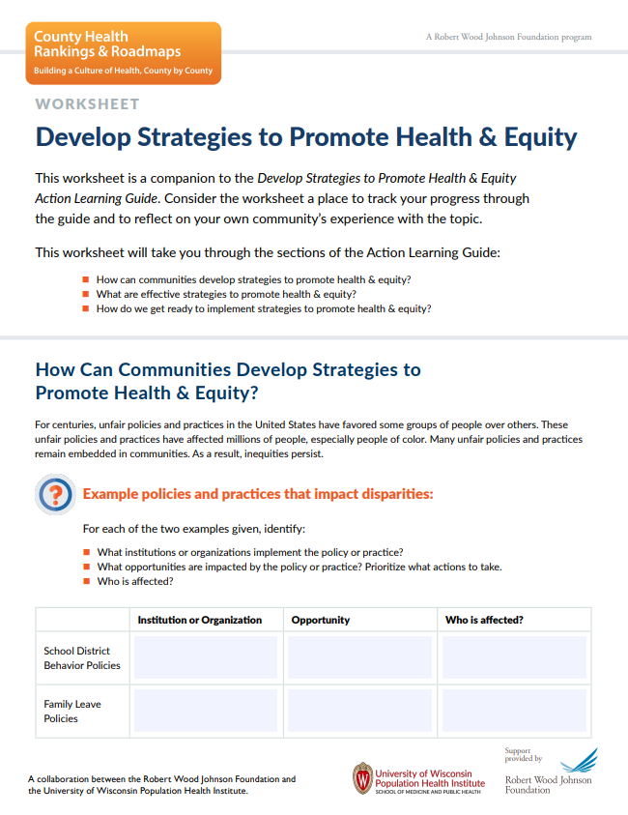
What you can expect
Learn from the content.
Learn from discussion and reflection.
Learn from taking action.
Notes:
Note for facilitator: This is a great time to introduce the companion worksheet to the Action Learning Guide. You may encourage everyone to utilize the worksheet digitally (https://www.countyhealthrankings.org/sites/default/files/media/document/chrr_developingstrategiesequity_worksheet.pdf) or by providing printed copies.
As we go through this guide together, we will:
Learn from guidance, tools, and examples to help you develop a deeper understanding of strategies that promote health and equity.
Have time to discuss and apply the learnings. Use the companion worksheet to capture your reflections and learnings.
Practice with tips and tools to help you put what you learn into action.

Slide 9
Root Causes of Inequities
Notes:
This image helps us understand root causes – the underlying conditions that cause the types of health outcomes that we see in a community.
The leaves and branches – things we easily see – represent health outcomes. The roots of the tree determine how the tree grows and how much it thrives. They are the conditions in a community that determine health outcomes and whether people have access to the opportunities and resources they need to thrive.
In the tree on the right, we see unhealthy roots like poor quality schools, poverty, and environmental toxins. This has resulted in the poor health that is visible in its branches. The tree on the right cannot grow well if its roots are not cared for.
The tree on the left looks much healthier, with things like adequate income, quality housing, and a clean environment supporting better health outcomes.
These differences in community conditions and health outcomes are the result of unfair and discriminatory policies and practices at many levels throughout society. They have created deep-rooted barriers to health. But communities have the power to create conditions that allow everyone to thrive.
Citation: Ramirez Brennan, L. K., Baker, E. A., & Metzler, M. (2008). Promoting Health Equity - A Resource to Help Communities Address Social Determinants of Health. Retrieved from https://www.cdc.gov/nccdphp/dch/programs/healthycommunitiesprogram/tools/pdf/SDOH-workbook.pdf

Slide 10
Community-Driven Solutions
Making health equity a shared vision and value.
Increasing community capacity to shape outcomes.
Fostering multi-sector collaboration.
Notes:
This graphic from Communities in Action: Pathways to Health Equity shows us what community-drive solutions look like.
The graphic puts the goal of healthier and more equitable communities at the center. It focuses on three key attributes of community-driven solutions:
Making health equity a shared vision and value.
Increasing community capacity to shape outcomes.
Fostering multi-sector collaboration.
The light blue ring highlights the social determinants of health. In this ring, we see that many factors shape a community’s health. We can link these factors to specific institutions in communities such as schools, businesses, hospitals, or government agencies. These institutions provide vital services. Their policies and practices shape a community’s health.
Citation: National Academies of Sciences, Engineering, and Medicine. 2017. Communities in Action: Pathways to Health Equity. 226/24624. Reproduced with permission the National Academy of Sciences, Courtesy of the National Academies Press, Washington, D.C.

Slide 11
Influence of Policy on Root Causes
School District Behavior Policies
Family Leave Policies
Unsplash, @cdc
Unsplash, NeONBRAND, @neonbrand
Notes:
For centuries, unfair policies and practices in the United States have favored some groups of people over others. These unfair policies and practices have affected millions of people, especially people of color. Many unfair policies and practices remain embedded in communities. As a result, inequities persist.
Businesses, government agencies, and schools provide vital community services. Their policies and practices influence whether community members have access to healthy opportunities.
Policy change is a pathway for addressing inequities. Communities can remove or revise policies that perpetuate inequities. They can adopt and promote policies that create opportunities for everyone, regardless of where they live or the circumstances they were born into. The following examples look at policies that create inequities and others that can positively disrupt them.
School and district-level zero-tolerance policies require schools to apply preset consequences for certain offenses. Zero tolerance means every person who breaks a rule receives the most severe consequence. Under zero-tolerance policies, school officials cannot consider the context or different circumstances that led to offenses.
When school districts set zero tolerance policies, they force some students out of school. This restricts their access to education and can perpetuate inequities. Students with disabilities and students of color, especially black students, are suspended or expelled more often than their peers, even for similar behavior or offenses.
As an alternative, many school districts across the country have implemented Positive Behavioral Interventions and Supports (PBIS). Studies show PBIS policies improve student behavior. These policies are likely to decrease disparities.
The federal Family and Medical Leave Act (FMLA) provides eligible workers with up to 12 weeks of leave to care for a newborn, a newly adopted child, or a sick family member. Workers can take this leave without losing their job or employee benefits. But because the leave is unpaid, it’s more difficult for people without financial resources to use. People who use FMLA leave are more likely to be people who can afford to take unpaid leave. They are primarily economically advantaged, college educated, and married.
Gaps in the FMLA coverage also create health inequities. The law doesn’t apply to employers with fewer than 50 employees. This leaves some people without access to the benefit. As much as 40 percent of the workforce lacks access to FMLA protections. Those without FMLA protections are more likely to be low-income or part-time workers.
Some states and several cities have passed paid family leave policies. These policies provide employees with paid time off for a recent birth or adoption, a parent or spouse with a serious medical condition, or a sick child. Paid family leave policies are likely to decrease disparities.
Citations:
Boccanfuso, C., & Kuhfeld, M. (2011). Multiple Responses , Promising Results : Evidence-Based , Nonpunitive Alternatives To Zero Tolerance. Child Trends, (March), 1–12. Retrieved from https://www.childtrends.org/?publications=multiple-responses-promising-results-evidence-based-nonpunitive-alternatives-to-zero-tolerance
Bradshaw, C. P., Waasdorp, T. E., & Leaf, P. J. (2012). Effects of school-wide positive behavioral interventions and supports on child behavior problems. Pediatrics, 130(5). https://doi.org/10.1542/peds.2012-0243
County Health Rankings & Roadmaps. (2018). Paid family leave . Retrieved December 6, 2019, from https://www.countyhealthrankings.org/take-action-to-improve-health/what-works-for-health/policies/paid-family-leave
Flannery, K. B., Fenning, P., McGrath Kato, M., & McIntosh, K. (2014). Effects of school-wide positive behavioral interventions and supports and fidelity of implementation on problem behavior in high schools. School Psychology Quarterly, 29(2), 111–124. https://doi.org/10.1037/spq0000039
Sheehy, H., & Pamukcu, A. (2018). 6 Federal Policies That Fall Short of Supporting Working Families. Retrieved October 11, 2019, from https://medium.com/changelab-solutions/6-federal-policies-that-fall-short-of-supporting-working-families-6d5d5d3e8352
US Department of Education (US ED). Guiding Principles: A Resource Guide for Improving School Climate and Discipline; 2014.

Slide 12
Discussion & Reflection
What institutions or organizations implement the policy or practice?
What opportunities are impacted?
Who is affected?
Notes:
Notes for facilitator:
This slide is meant to be a learning check on the “Identify strategies to promote health and equity” learning objective. The slide is animated and questions will appear one at a time. These discussion prompts are great for group discussion and can also be completed on the individual worksheet.
Consider starting the participants with individual reflection and then group reflection will reinforce learning. You can do this by suggesting, “Take five minutes to write your own thoughts on the worksheet, then we’ll come together as a group to discuss this.”
Discuss as many ideas as time allows. Consider writing down some of the common responses to the questions which may be helpful to refer back to as you move through the guide.
Participant prompt: Think about the examples of the school district behavior and family leave policies. For each of these examples, identify:
What institutions or organizations implement the policy or practice?
What opportunities are impacted by the policy or practice? Prioritize what actions to take.
Who is affected?

Slide 13
Kansas City, MO: Influence of Policy on Root Causes
Notes:
Let’s see how policy influences root causes of health inequities by looking at a community story. We’ll see that efforts to develop strategies to promote health and equity may feel complex, but communities have the power to do it.
Notes for facilitator: Options for facilitating include -
View the video together as a group, if time allows (approximately 3-1/2 minutes).
Read the story narrative below.
Kansas City in Missouri is a city known for devoted sports fans, legendary barbecue, and stunning fountains—is working hard to give its half- million residents something else to be proud of: health equity for all.
The challenges here are not for the faint of heart. A history of segregation and discrimination created gaps and inequities that remain woven throughout the community. They affect everything from access to healthy foods to education to community safety.
In 2000, the Kansas City Health Department released a report revealing that life expectancy for White residents was 6.5 years more than their Black neighbors. Leaders and residents in Kansas City decided to do something about this disparity..
To really make a difference, city officials knew they had to start by identifying strategies to address the root causes of poor health. That meant having frank discussions on race and the impact of violence. It meant looking at the policies and practices of the institutions in their community to increase educational opportunities, improve access to care, and ensure economic justice.
Kansas City residents and leaders took this on by:
Partnering across sectors to interrupt violence through the Aim4Peace program.
Training teachers to identify students experiencing trauma and connect them with help.
Passing a new property tax dedicated to fund hospital and public health activities.
Changing zoning laws to encourage urban agriculture.

Slide 14
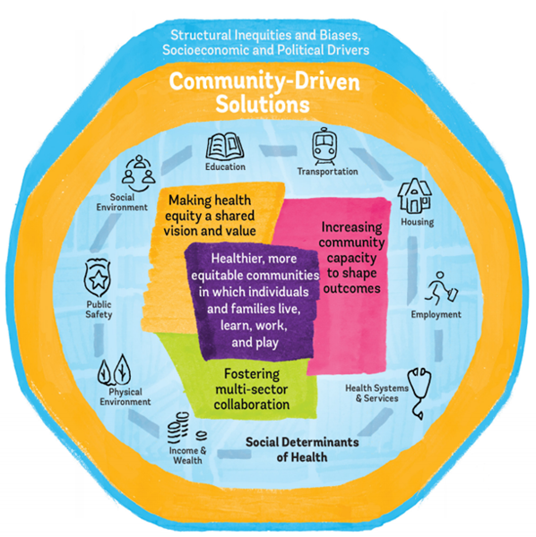
Discussion & Reflection
What institutions or organizations worked together to address health inequities?
Which social determinants or health were they trying to impact?
Notes:
Notes for facilitator:
This slide is meant to be a learning check on the “Identify strategies to promote health and equity” learning objective. The slide is animated and questions will appear one at a time. These discussion prompts are great for group discussion and can also be completed on the individual worksheet.
Consider starting the participants with individual reflection and then group reflection will reinforce learning. You can do this by suggesting, “Take five minutes to write your own thoughts on the worksheet, then we’ll come together as a group to discuss this.”
Discuss as many ideas as time allows. Consider writing down some of the common responses to the questions which may be helpful to refer back to as you move through the guide.
Participant prompt: Think about the Kansas City story and reflect on the Communities in Action: Pathways to Health Equity graphic we saw earlier (slide 10).
What types of institutions or organizations worked together to address health inequities in the city?
Which social determinants were they trying to impact?

Slide 15
Key Takeaways
Community-led solutions are needed to effectively promote health and equity.
Unfair policies and practices remain embedded in communities and institutions. This causes them to persist.
Communities can remove or revise policies that perpetuate inequities.
Communities can adopt and promote policies that create opportunities for everyone.
Notes:
Notes for facilitator:
The slide is animated and key takeaways will appear one at a time. This is a great moment to clarify content as needed and for group reflection before moving on to the next content section.
This slide is meant to be a learning check on the “Identify strategies to promote health and equity” learning objective.

Slide 16
What are Effective Strategies?
Policies
Programs
Practices
Systems
Environment
Plan of action to achieve a goal - what you will do to promote health and equity.
Continues to occur when it becomes part of practices and policies.
Notes:
As we saw in the previous example policies, trying to address equity without taking on policy change can perpetuate health disparities. The good news is there are effective strategies to address root causes of health inequities.
Before we take a look at what makes a strategy effective, let’s first explore what we mean by strategy.
A strategy is a plan of action designed to achieve an overall goal. Think of it as what you will do to promote health and equity.
It could be changes to policies, programs, practices, systems, or the environment.

Slide 17
Evidence-Informed Strategies
Scientifically Supported | Tested in multiple studies with consistently favorable results. Most likely to make a difference.
Some Evidence | Tested more than once with trending favorable results. Likely to work.
Expert Opinion | Recommended by credible experts, but have limited testing. Effects need to be confirmed through research.
Insufficient Evidence | Have not been widely tested or have limited research about effects.
Mixed Evidence | Have been tested more than once and yielded inconsistent results.
Evidence of Ineffectiveness | Have been tested and consistently yielded unfavorable or harmful results. Not good investments.
Notes:
Selecting and implementing strategies that have been shown to work in real life and that are a good fit for a community will maximize the chances of success.
Several organizations assess and rate policy and program effectiveness. You might find different kinds of evidence to support strategies and different labels describing how well they work (e.g., promising practice, best practice, model program, etc.).
These labels (and how groups arrive at them) are not apples-to-apples comparisons. Each group has its own criteria and labels. It’s important to understand what they mean.
As an example, look at the definitions of the evidence ratings in County Health Rankings & Roadmaps’ What Works for Health.
Notes for facilitator:
As you read through the terms and definitions on the slide, pause to clarify questions and check understanding.
If the group wants to explore other ratings, refer to the “Our Sources” content on the What Works for Health site - https://www.countyhealthrankings.org/take-action-to-improve-health/what-works-for-health/our-sources

Slide 18
Community Context
Is the strategy feasible?
Do resources exist to implement it?
Will the strategy improve policies and practices?
Will it address root causes of health inequities?
Is there political support for the strategy?
Is there community support?
culture
history
environments
resources
assets
challenges
Notes:
Evidence matters, but so does community context. Every community has a unique context, influenced by its residents, culture, history, environments, location, and resources, assets and challenges. These factors provide a foundation from which to build. Understanding the unique factors and dynamics that make up a community’s context helps to direct and leverage strategies for sustainable impact.
Whether considering an evidence-informed strategy or a more innovative approach, it’s important to consider the community’s culture, priorities, and resources along with evidence of effectiveness. Think about things like:
How feasible is it to implement your preferred strategy in your community?
Are there resources available to implement the strategy?
Does the strategy improve policies and practices affecting health inequities?
Is there political will to support it?
Is your community ready for the strategy? Will they support it?
Can we expect the strategy to do what we want it to do? Will it address root causes of health inequities?
Participant prompt: Think about your own community. What is unique about its community context – it’s culture, history, assets, challenges, etc. – that would be important to consider when selecting strategies to address health equity?
Note for facilitator: Discuss as many ideas as time allows.
Citation: Community Context. (n.d.). Retrieved from https://healthyplacesbydesign.org/community-context/

Slide 19
Engage Stakeholders
Community members: residents, advocacy groups, non-profit agencies, businesses.
Decision Makers: elected and appointed officials, lobbying groups.
Implementers: business owners and employees, school administrators and staff, hospital administrators and staff.
Photo credit: Unsplash, tribesth kayastha
Notes:
To have the greatest impact and success, engage a broad group of stakeholders who can provide a full picture of the community’s context. Include:
Community Members - people invested in improving health. This might include:
residents - especially those most impacted by inequities.
advocacy groups
non-profit agencies, and
businesses.
Decision Makers - those who have the power to influence or make decisions about policy changes. This might include:
elected and appointed officials or
lobbying groups.
Implementers - the people tasked with making the strategy work. This is an important group—a strategy only works if it’s implemented or enforced. This might include:
business owners and employees,
school administrators and staff, and
hospital administrators and staff.

Slide 20
What Works for Health
Notes:
Keeping in mind that evidence and community context matters when selecting strategies to promote health and equity, let’s explore a tool to help you find ideas to start.
What Works for Health contains more than 400 evidence-informed policies and programs that can make a difference in community health improvement efforts. It contains assessments and summaries about the best available evidence for strategies across a variety of health-related issues. Using this tool can give you a sense of what works, what might work, and what does not work. What Works for Health supports the use of tried-and-true strategies, as well as innovative approaches to challenges.
Let’s use What Works for Health to practice considering evidence and community context in selecting a strategy to address health equity.
Notes for facilitator:
This activity has been most effective when small groups (3-4) work together to complete the steps. Each group will need access to a computer and the internet. Encourage them to use the worksheet to document their work on each step (https://www.countyhealthrankings.org/sites/default/files/media/document/chrr_developingstrategiesequity_worksheet.pdf).
Though smaller groups may work together to complete each step, consider showing the slide and providing guidance for each step to the entire group, then giving them a certain amount of time to work to complete each step. This will enable you to keep the group moving at the same pace, and address questions as they arise during the activity.
You may choose to have each group select the same or a different issue to focus on (Step 1).

Slide 21
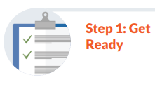
What Works for Health
What do you want to accomplish to promote health and equity?
Which social determinants of health can have the most impact in your community?
What are some related key words?
Notes:
The first step is to focus on an issue that will promote health and equity in the community. On the worksheet, briefly describe what you want to accomplish and which social determinants of health can have the most impact. Consider:
Is there a specific health outcome or issue that is a concern in the community?
Are there groups of residents with worse outcomes than others?
Now think about key words or terms that are related to your area of focus.
For example if you want to address food insecurity in the community, what are some related words that might help you find useful strategies?
To come up with key words to search, think about:
How is food related to good health?
Where do people in a community typically access food?
What institutions or organizations provide food in a community and who are the decision makers?
Key words include: food, nutrition, school food, food pantries, markets.

Slide 22
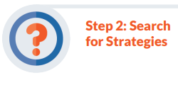
What Works for Health
Identify key words then use the “Search all strategies by keyword” box.
Use the menu on the left to browse strategies by health topic or factors, decision makers, or evidence ratings.
Notes:
Now you can use What Works for Health to find strategies. Go to the What Works for Health web page - https://www.countyhealthrankings.org/take-action-to-improve-health/what-works-for-health
Find the “Search all strategies by keyword” box, and type in the key words you identified.
You can also use the search box to browse strategies by related social determinants or health factors, decision makers, or evidence rating.
Look at the types of strategies you find and which ones have strong evidence ratings. Are there ideas that make sense considering the community’s context?
If you need more strategy ideas, fine-tune your search. Think of new key words – synonyms, related words, or types of root causes of health inequities.
If too many strategies were generated by your search, use the menu on the left of the page to narrow by approach, decision maker, or evidence rating.

Slide 23
What Works for Health
Will the strategy work? (Evidence Rating)
What can it accomplish? (Expected Beneficial Outcomes)
Will it work in a local community? (Evidence of Effectiveness)
Will it address health gaps? (Impact on Disparities)
Are there helpful resources to help with implementation?
Does the strategy align with the community’s context?
Notes:
Click on a strategy title and review the information. Make notes on the worksheet about:
The Evidence Rating to get a sense of how likely the strategy is to work, based on best available evidence.
The Expected Beneficial Outcomes to understand what the strategy can accomplish.
The Evidence of Effectiveness summary to get an idea of whether a strategy is likely to work locally.
The Impact on Disparity rating to get a sense of how the strategy will likely impact disparities or gaps among: socio-economic groups, racial or ethnic groups, and geographic areas (i.e., urban vs. rural).
The Implementation Examples & Resources to get ideas of how you might move forward on selecting and acting on a strategy.
How the strategy fits within the community’s context.

Slide 24
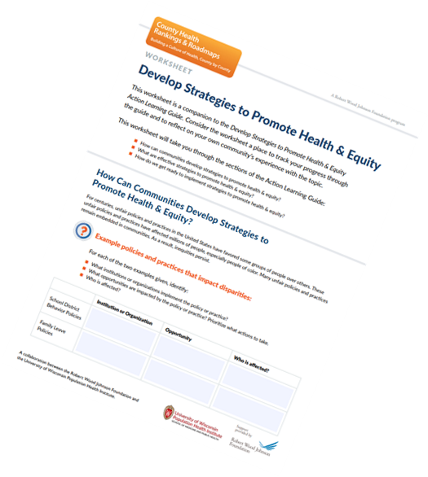
Discussion & Reflection
What are strategies that might work to promote health and equity in the community?
Who is needs to be engaged in identifying and implementing strategies?
Notes:
Notes for facilitator:
This slide is meant to be a learning check on the “Describe essential practices to identify and select strategies that promote health and equity in your community’s context” learning objective. The slide is animated and questions will appear one at a time. These discussion prompts are great for group discussion and can also be completed on the individual worksheet.
Consider starting the participants with individual reflection and then group reflection will reinforce learning. You can do this by suggesting, “Take five minutes to write your own thoughts on the worksheet, then we’ll come together as a group to discuss this.”
Discuss as many ideas as time allows. Consider writing down some of the common responses to the questions which may be helpful to refer back to as you move through the guide.
Participant prompt: Reflect on the what we discussed about the value of evidence-informed strategies, the importance of tailoring strategies to fit within community context, and the strategies you explored using What Works for Health.
What are some new strategies that might work to promote health and equity in the community?
Consider the types of stakeholder groups discussed earlier (reference slide 19). Who in the community is currently engaged in identifying and implementing strategies to address root causes of health inequities? Who is missing and needs to be engaged?

Slide 25
Key Takeaways
Evidence-informed strategies can help a community address root causes of health inequities.
Community stakeholders bring unique value to inform how a strategy might work within the context of the community.
Community members, decision makers, and implementers are important stakeholders to engage in addressing root causes of health inequities.
Notes:
Notes for facilitator:
The slide is animated and key takeaways will appear one at a time. This is a great moment to clarify content as needed and for group reflection before moving on to the next content section.
This slide is meant to be a learning check on the “Describe essential practices to identify and select strategies that promote health and equity in your community’s context” learning objective.

Slide 26
Community-Driven Solutions
Notes:
Let’s revisit the Communities in Action: Pathways to Health Equity graphic we looked at earlier (slide 10).
The graphic puts the goal of healthier and more equitable communities at the center. It focuses on three key attributes of community-driven solutions:
Making health equity a shared vision and value.
Increasing community capacity to shape outcomes.
Fostering multi-sector collaboration.
Let’s take a closer look at each of these attributes to understand how to get ready to implement strategies to promote health and equity.
Citation: National Academies of Sciences, Engineering, and Medicine. 2017. Communities in Action: Pathways to Health Equity. 226/24624. Reproduced with permission the National Academy of Sciences, Courtesy of the National Academies Press, Washington, D.C.

Slide 27
Make Health Equity A Shared Vision and Value
Vision: Beliefs and governing principles
What is our dream for the community?
How do we want to be in the future?
How great can the community become?
What do we want to create together?
Notes:
Create a shared vision for health equity by having intentional conversations with community members and multi-sector partners.
What is a vision? Your vision clarifies the beliefs and governing principles for your group and for the community. It answers questions like:
What is our dream for the community?
How do we want to be in the future?
How great can our community become?
What do we want to create together?
Your collective answers to these questions will help you express a shared vision for promoting health and equity in your community. Your vision expresses the value you and your partners place on health equity. It should be the point for impact and may be just one to three sentences.

Slide 28
Make Health Equity A Shared Vision and Value
“A world where everybody has the opportunity to be healthy.” –The Health Equity Initiative
“The Boston Public Health Commission envisions a thriving Boston where all residents live healthy, fulfilling lives free of racism, poverty, violence, and other systems of oppression. All residents will have equitable opportunities and resources, leading to optimal health and well-being.” –The Boston Public Health Commission
“Our vision is a nation of healthy, equitable communities where everyone reaches their full potential. We believe that health and wellbeing are essential human rights. We seek to create impact where it is most needed, respecting and honoring the voices of people who face the starkest health disparities and whose stories too often go unheard.” –Healthy Places by Design
Notes:
Let’s look at some examples of vision statements that focus on equity.
Notes for facilitator: Pause and allow participants to read the three examples. Then, consider engaging in a brief group discussion using the participant prompts below.
Participant prompt:
What key words stand out to you as you read the vision statements?
In the vision statements, what makes you feel or sense the group’s commitment to health equity?
Citations:
Health Equity Initiative. (n.d.). Retrieved February 26, 2020, from http://www.healthequityinitiative.org/hei/about/our-vision/
Our Mission and Vision. (n.d.). Retrieved February 26, 2020, from https://www.bphc.org/aboutus/office-director/Pages/Our-Mission-and-Vision.aspx
Who We Are (n.d.). Retrieved February 26, 2020, from https://healthyplacesbydesign.org/who-we-are/

Slide 29
Strategy Selection Criteria
Impact: What is the likelihood that the strategy will work?
Cost-benefit: Are there foreseen or unintended results that could outweigh the potential positive outcomes of the strategy?
Influence: Are community stakeholders in a good position to carry out the strategy?
Community Readiness: Will community stakeholders be supportive of this strategy?
Policy Impact: Does the strategy address policies or practices that affect inequities?
Opportunity: Are there other strategies to leverage or build on?
Resources: Does the community have access to the resources needed to implement the strategy?
Notes:
Once the group has a shared vision, take time to clearly define the criteria for selecting strategies to address health equity.
Criteria expresses the values, standards, and ideas you will consider when making choices. A shared set of criteria can minimize false assumptions and confusion among partners and decision makers. You can also use these criteria to monitor progress or impact as you implement a strategy.
Note to facilitator: The slide is animated and bulleted item will appear one at a time.
Strategy selection criteria may include:
Impact. What is the likelihood that the strategy will address a root cause of health inequities? Is there evidence that the strategy will impact the problem you are trying to solve, improve lives, and reduce disparities?
Cost-benefit. Are there foreseen or unintended results that could outweigh the potential positive outcomes of the strategy? Is the strategy an “easy win” or “low-hanging fruit”?
Influence. Are community stakeholders in a good position to carry out the strategy? Do you have previous experience or success with similar strategies?
Community Readiness. Can we tailor the strategy to fit our community’s context ? Will community stakeholders be supportive of this strategy?
Policy Impact. Does the strategy address policies or practices that affect inequities? Is the institution likely to affect policy change?
Opportunity. What is already happening related to the strategy? Are there other policies this strategy could leverage or build on?
Resources. Does your community have access to the resources needed to implement the strategy?
Taking time to develop shared criteria is worth the time and effort. You may want to revisit them as community context or conditions change.

Slide 30
Foster Multi-Sector Collaborations
Multiple Sectors: Who is already engaged? Who needs to be engaged?
Skills and Experiences: assessment, coalition building, community networks, policy advocacy and implementation
Community Residents as active participants and leaders
Notes:
Everyone has a role to play in realizing a vision of health equity. Efforts will be more effective if they include people from multiple sectors and people experiencing inequities.
Who should be involved? As you think about who should be involved in your efforts, consider engaging:
people from multiple sectors,
partners with skills related to making change happen,
community members, and
people experiencing inequities.
Reflect on the institutions in your community that shape health outcomes. Think schools, businesses, hospitals, or government agencies. Who's already engaged? Who’s missing?
Strong partnerships include people with skills and experiences that are needed to make change happen such as:
assessment and planning,
coalition building,
local knowledge,
community networks,
facilitation,
communications,
policy advocacy and implementation, and
coordinating community events.
Community engagement is an important topic among those seeking to create healthy communities—with good reason. Community residents, especially those most affected by poor health outcomes, are essential partners.
Resident engagement includes a balance of practices that:
Raise resident awareness and participation;
Gather feedback and input from residents;
Involve residents as active leaders.
Most partnerships start, and sometimes stay, in increasing awareness and getting feedback. Supporting active resident leadership can feel like a stretch for some communities. This is challenging work. Let’s explore some tips to get started.
Citation: Stojicic, P., Wright, K., & Creegan, A. (2018). Keep Three Approaches in Balance for Successful Resident Engagement | ReThink Health. Retrieved April 13, 2018, from https://www.rethinkhealth.org/the-rethinkers-blog/keep-three-approaches-

Slide 31
Meaningful Community Engagement
Meet people where they are. Consider how you can go to them rather than asking them to come to you.
Talk to people and with people, not at people. Find out what is important to them.
Start off on the right foot. Welcome people in a way that makes them feel safe and valued.
Keep at it. Connecting with others and building relationships is an ongoing process.
Notes:
Here are some tips for connecting with community members and potential partners in a meaningful way. It is about building relationships and is the most important part of creating long-lasting community change.
Meet people where they are. The community is already organized, so consider ways to reach community members where they are. Places of worship, neighborhood associations, and parent groups may be good places to start. The same is true for engaging other organizations. Consider how you can go to them rather than asking them to come to you.
Talk to people and with people, not at people. Find out what is important to them. What do they care about? What is their interest in your issue?
Start off on the right foot. Consider the culture of your partnership. How will you welcome people in a way that makes them feel safe and valued?
What barriers might keep people from sharing their experiences and perspectives?
What will it take to remove those barriers?
Keep at it. Connecting with others and building relationships is an ongoing process. Keep reaching out to organizations and community members to build additional skills, knowledge, resources, and involvement in your work.

Slide 32
Increase Community Capacity to Shape Outcomes
Sharing Power:
Who decides?
What issues are decided?
How are they decided?
Are community members empowered in the decision making process?
Is anyone resistant to sharing power?
Notes:
Increasing the community’s capacity to shape outcomes requires sharing power.
The United States has a long history of racism and discriminatory policies and practices that have favored some groups of people over others. To address equity in a lasting way, communities must address power imbalances and directly confront oppression. That means working with others to change the policies and systems that reinforce the status quo.
Without understanding power dynamics, we can inadvertently reinforce the status quo. But how do we understand power dynamics?
Begin with curiosity. We can begin to understand the power structures in our communities by exploring the following questions:
Who decides? Who’s in the room? Who isn’t in the room?
What issues are decided? What gets on the agenda? For everything that makes it on the agenda, there are other things that are left behind.
How are they decided? What rules apply?
If residents have not traditionally had this type of power to influence and make decisions, consider what barriers they face. Consider things like:
How can you create an environment where community members feel comfortable and safe? (e.g., location, language, and format)
Will those who currently hold decision-making power be resistant to sharing power?
How can you prevent disengagement or dissent from those who currently hold more power than others?
You don’t have to do this work alone. As you seek to shift the balance of power, look to groups or networks within your community that are already working directly with residents on building power within communities that face inequities.
Note to facilitator: The National Organizations with Local Connections document offers some examples of groups to look for that may have deep connections in your community - https://www.countyhealthrankings.org/sites/default/files/resources/CommunityEngagement_National%20Resources.pdf
Citations:
Citizen University TV Ep3: Who Decides. (2016). Citizen University. Retrieved from https://www.youtube.com/watch?time_continue=693&v=NUnlaiUD2J8
Parker, C. S., Guinee, L. N., & Nagel, A. (n.d.). Leveraging Diversity and Building Power Fostering collaboration. Retrieved from www.interactioninstitute.org

Slide 33
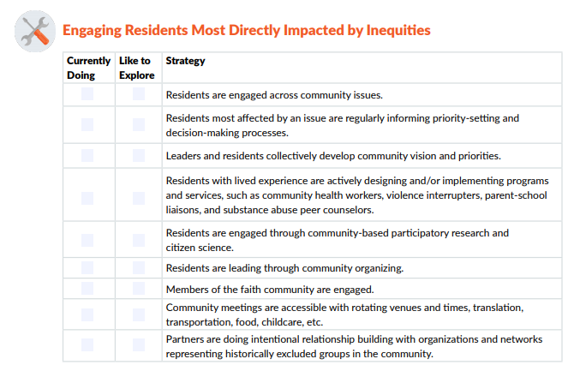
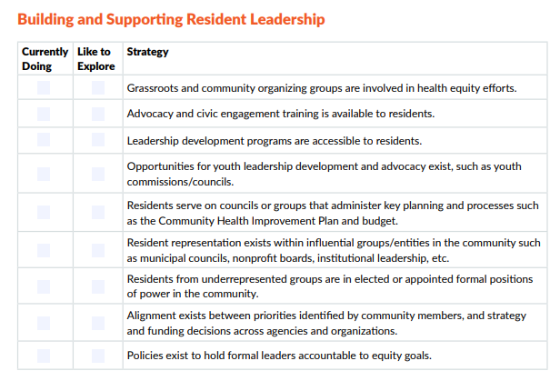
Exploring Strategies From Communities
Notes:
We’ve just spent some time learning how making health equity a shared vision, fostering multi-sector collaborations, and increasing capacity to shape community outcomes are important components to getting ready to implement strategies.
Now, let’s get some inspiration by exploring strategies that have actually been implemented in communities across the country.
Examples from the Robert Wood Johnson Foundation Culture of Health Prize show that there are communities that have made real progress in identifying and implementing strategies to ensure everyone has a fair and just opportunity for health. The Prize acknowledges communities across the country that are at the forefront of advancing health, opportunity, and equity for all.
Participant prompt: Refer to page 5 of the worksheet. As you read through the list of strategies, either put a check next to any strategies that you and your partners are currently doing or next to strategies that you would like to explore.
Notes for facilitator:
Consider starting the participants with individual reflection and then group reflection will reinforce learning. You can do this by suggesting, “Take five minutes to write your own thoughts on the worksheet, then we’ll come together as a group to discuss this.”
Discuss as many ideas as time allows.
Citation: University of Wisconsin Population Health Institute. Actions Toward Equity: Strategies Communities Are Using to Ensure Everyone Has a Fair and Just Opportunity for Health, A report based on RWJF Culture of Health Prize Winners 2013-2017. Summer 2019.

Slide 34
Columbia Gorge, Oregon and Washington
Notes:
We can also be inspired by partners in the Columbia Gorge Region of Oregon and Wisconsin. As you hear their story, think about how you might implement strategies to promote health and equity in the community.
Notes for facilitator: Options for facilitating include -
View the video together as a group, if time allows (approximately 3-1/2 minutes).
Read the story narrative below.
A shared vision and commitment is a cornerstone of the partnership’s process and includes involvement and leadership by people impacted by health disparities. They put and keep community needs at the forefront of their community health improvement efforts by:
Asking what residents need,
Valuing residents as “experts” who provide lived experiences, and
Actively responding to what residents share.
Poverty, food insecurity, and the vast rural geography of the region led to health disparities. When the governor of Oregon signed into law a new system for managing federal dollars for the medical needs of low-income residents, partners in the Columbia Gorge Region made a big decision.
Mark Thomas, chaplain at Providence Hood River Memorial Hospital said, “We could have a lot more traction and our solutions could be more effective, if we actually slowed down and listened to the people we aim to serve.”
That directive became a catalyst for creating a more collaborative approach for shaping policy and improving results.
People saw a chance to start a broader, deeper discussion on health, reaching across all sectors of the community. A tangible result has been giving a voice to the region’s Latino population which had been historically isolated from decision making about health issues. About one in four Columbia Gorge residents is Latino, with many families arriving as migrants to work in the orchards.
“First we were not heard, then we had to shout to be heard, and now we can talk together in the same room,” said Elizur Bello, a program manager at The Next Door, a social services nonprofit that serves the Latinx community.

Slide 35
Discussion & Reflection
Notes:
Notes for facilitator:
This slide is meant to be a learning check on the “Describe how communities can implement strategies in ways that promote health and equity” learning objective.
These discussion prompts are great for group discussion and can also be completed by individuals on the worksheet.
Consider starting the participants with individual reflection and then group reflection will reinforce learning. You can do this by suggesting, “Take five minutes to write your own thoughts on the worksheet, then we’ll come together as a group to discuss this.”

Slide 36
Key Takeaways
Community residents and multi-sector partners – each with unique and valuable experiences - are needed to uncover the conditions that promote health and equity.
Community residents and stakeholders should be engaged in identifying or creating solutions to promote health and equity.
A shared vision and shared criteria are essential in identifying strategies to address root causes of health inequities.
Notes:
Notes for facilitator:
The slide is animated and key takeaways will appear one at a time. This is a great moment to clarify content as needed.
This slide is meant to be a learning check on the “Identify root causes of inequities that influence health” learning objective.

Slide 37
Congratulations!
You have completed the Develop Strategies to Promote Health and Equity guide, and can:
Identify strategies to promote health and equity.
Describe essential practices to identify and select strategies that promote health and equity with the community’s context.
Describe how communities can implement strategies in ways that promote health and equity.
Notes:
Now that we have completed the Understand and Identify Root Causes of Inequities guide together, you should be able to:
Define root causes of inequities that influence health.
Explain why root causes matter in community health improvement efforts.
Identify root causes of inequities that influence health.
Congratulations and thank you for your efforts to improve community health!

Slide 38
Contact Us
We would love to hear your thoughts on this guide or to discuss any questions you have!
Contact us
Notes:
Click the “Contact us” text in this presentation, or at our website (https://www.countyhealthrankings.org/about-us/contact-us) to reach us.
Note for facilitator: Thank you for using this guide to lead your group or coalition through learning about how to understand and identify root causes of health inequities. If you have any questions or feedback, please reach out at https://www.countyhealthrankings.org/about-us/contact-us

