Slide 1
County Health Rankings & Roadmaps 101
[Presenter Name]
countyhealthrankings.org
Notes:
County Health Rankings & Roadmaps is a collaboration between the Robert Wood Johnson Foundation and the University of Wisconsin Population Health Institute.
The County Health Rankings & Roadmaps show us that where we live matters to our health. The purpose of this presentation is to provide you with an general overview of County Health Rankings & Roadmaps.

Slide 2
Outcomes
Understand why this work matters
Be prepared to use data, evidence, guidance, and stories to support your work
Notes:
KEY POINTS
By the end of this presentation you will:
Understand why this work matters
Be prepared to use Data, Evidence, Guidance and Stories to support your work.

Slide 3
Why we do what we do
Menominee Nation 2015
Improve Health Outcomes
Notes:
KEY POINTS
Let’s start with the “why.” Why does County Health Rankings & Roadmaps exist?
County Health Rankings & Roadmaps has two primary, overarching goals.
The first is to improve health outcomes for all – this includes both how long people live, and how healthy they are.
Photo: Menominee Nation, WI. 2015 Culture of Health Prize Winner.

Slide 4
Why we do what we do
Durham, NC 2014
Increase Health Equity
Notes:
KEY POINTS
The second goal is to close the health gaps between those with the most and least opportunities for good health.
Everyone should have a fair opportunity to be as healthy as possible, regardless of where we live or the circumstances we were born into. The choices we make depend on the opportunities we have - things like access to healthy foods or a quality education, or living in safe and affordable housing and crime-free neighborhoods. Not everyone has these opportunities.
These unequal opportunities create differences in health, do not come about on their own or because of the actions of individuals alone. They are often the result of policies and practices at every level that have created deep-rooted barriers to good health for some people. We see this in things like bank lending practices and school funding based largely on local property taxes. That means that everyone does not have a fair and just opportunity to live a long and healthy life.
But communities have the power to change this.
Photo: Durham County, NC. 2014 Culture of Health Prize winner.

Slide 5
Notes:
KEY POINTS
This graphic helps us understand why equality is just the starting point to closing gaps. We need more than the SAME resources or opportunities available to all. For example, the SAME adult bike would not allow everyone to ride safely to get to where they want to go, and some could not even ride it at all.
But let’s think about an equity approach where everyone again has a bicycle, but the type is based on what they need for their circumstances.
Inequities result when there is a lack of opportunity and resources to thrive – in this example, a bike that meets different needs. It’s important to remember that these conditions and obstacles are both unfair and avoidable.
NOTE TO PRESENTER:
The graphic is a GIF, which will play when PowerPoint is in presenter mode.
A static image of the same content is available here: https://www.rwjf.org/en/library/infographics/visualizing-health-equity.html

Slide 6
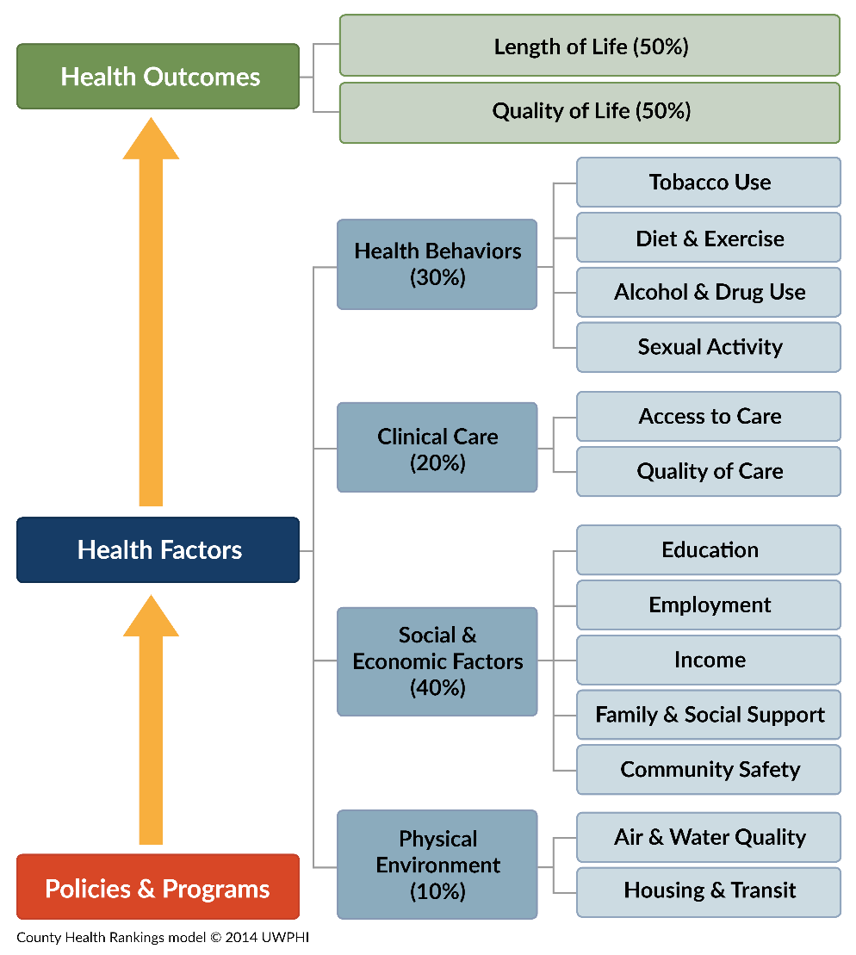
Notes:
KEY POINTS
Rankings model shows:
1. Health Outcomes: “Today’s health” (the green boxes)
Length of life – tells whether people are dying too early
Quality of life – tells how well people feel while living
2. Health Factors: “Tomorrow’s health” (the blue boxes)
Health behaviors
Clinical care
Social and economic factors
Physical environment
These are factors that determine how long people live and the quality of their lives. The blue boxes are things communities can work on now to help improve their future health.
3. Policies and Programs impact health factors and ultimately health outcomes. (orange box)
Alternative: WALK THROUGH THE MODEL
Starting from the bottom, we believe: effective local, state, and federal Policies and Programs (orange box) can improve a variety of factors that, in turn, shape the health of communities.
Many Health Factors (the blue boxes) shape our communities' health outcomes. We specifically look at health behaviors, clinical care, social and economic factors, and the physical environment.
We measure two types of Health Outcomes (the green boxes) to show how healthy each county is: length of life and quality of life.
Example 1:
A clean indoor air policy is a policy that can influence health factors, such as tobacco use, which in turn influences health outcomes.
We often point to this image as one of our most important, because it outlines what we use to determine the County Health Rankings and what influences health in a community. Because much of what affects our health happens beyond medical care, the Rankings underscore how important it is to build a culture of health where getting healthy, staying healthy, and making sure our kids grow up healthy are top priorities.
Example 2:
Policies and programs which expand early childhood education can help improve academic achievement.
Higher levels of education lead to higher levels of income which then influence other health factors such as access to healthy foods, clinical care, and quality housing, which in turn influence health outcomes.
Stepping back:
You’ll note that we don’t include race or ethnicity in our health factors. We’ve selected health factors that reflect aspects that communities can improve. Race and ethnicity are not modifiable, while poverty is something we can take action on, so you will see “income” as a key health factor.
We do provide data, tools and resources that can help communities address health disparities, and we’ll show you later where to find these on our site. The bottom line is that factors such as one’s race, ethnicity, and socioeconomic status should not play a role in how healthy we are or how long we live. Unfortunately, for many people across the nation, they do. If we are going to build a Culture of Health in every community, reducing health disparities needs to be a top priority - because everyone in our society deserves an equal opportunity to pursue a healthier life.
___________________________________________
NOTE TO PRESENTER:
This is THE MOST IMPORTANT SLIDE in the deck. It’s as important as the numbers that go into the Rankings. It helps people tell important story about the many factors that determine health.
TOOL: Consider building in an activity using the County Health Rankings Model Discussion Guide, which offers reflection questions and tips for a facilitated conversation about the County Health Rankings model.
http://www.countyhealthrankings.org/county-health-rankings-model-discussion-guide

Slide 7
How communities create change
Take Action Cycle
Notes:
KEY POINTS
The County Health Rankings are intended to serve as a call to action, to ignite action in communities across the country.
The Take Action Cycle illustrates the HOW of creating a healthy community.
Community transformation begins with the steps in the Take Action Cycle, starting with Assessing Needs and Resources and moving through to evaluation.
Communicate and Work Together wrap around the cycle because these activities are essential throughout, no matter what step you are in.
At the heart of the Take Action Cycle is people working together. We know that when people work together with a shared vision and commitment to improve health, it can yield better results than working alone.
While these images might look pretty simple, we know that putting these ideas into practice is challenging. We’ve developed various tools and resources to help you.

Slide 8
How we Support Communities
DATA
EVIDENCE
GUIDANCE
STORIES
Notes:
KEY POINTS
County Health Rankings & Roadmaps helps communities bring people together to look at the many factors that influence health, select strategies that can improve health for all, and make changes that will have a lasting impact. Here’s how:
Data to reveal the factors that influence health.
Evidence to highlight the strategies that work
Guidance to put those strategies into action, and
Stories of real-world experiences to inspire and inform your efforts.
Photos (L to R, top to bottom)
Allen County, Kansas. 2017 Culture of Health Prize winner.
Taos Pueblo. 2014 Culture of Heath Prize winner.
Richmond, VA. 2017 Culture of Heath Prize winner.
Columbia Gorge Region, OR and WA. 2016 Culture of Heath Prize winner.

Slide 9
DATA
Allen County, KS 2017
Using data to reveal the factors that influence health
Notes:
KEY POINTS
Data can be used all throughout the community health improvement process.
It can be used to assess the health of a community
Communities across the country are incorporating County Health Rankings data into community health needs assessments, as well as other health improvement strategies.
Data can also be a tool for engaging communities in health improvement, including nontraditional community partners and community members
The Rankings prompted a “sense of urgency” for the United Way of Greater Toledo (OH) along with the community it represents. The County Health Rankings model became a tool to talk about the social determinants of health and how to respond.
Identify the root causes of health issues
The Menominee Nation of Wisconsin, a 2015 Culture of Health Prize winning community, used the Adverse Childhood Experiences scale as a screening tool to measure the community’s children’s exposure to traumatic experiences. When they found many members with scores indicating a high risk of health problems, the tribe decided to take a trauma-informed approach to health that focused heavily on consistently evaluating the mental and emotional well-being of residents and providing the supports they needed to move toward healing.
Support decision-making and policy change
Track progress
As communities take action, they have used data from the Rankings and other sources to understand whether policies, programs, or plans are on track to improve health.
____________________________________
NOTE TO PRESENTER:
This section includes
example of a county’s snapshot from the website
Tools to help you further explore and understand your data
Photo: Allen County, Kansas. 2017 Culture of Heath Prize winner.

Slide 10
County Health Rankings: 2 Rankings
Health Outcomes
Today’s Health
Health Factors
Tomorrow’s Health
Notes:
KEY POINTS
The County Health Rankings ranks the health of nearly every county in every state.
For each county, you will find two rankings, one for Health Outcomes and one for Health Factors.
There are two separate sets of messages to convey.
How healthy a county currently is (Health Outcomes)
How healthy a county might be in the future based on the many factors that influence health (Health Factors).

Slide 11
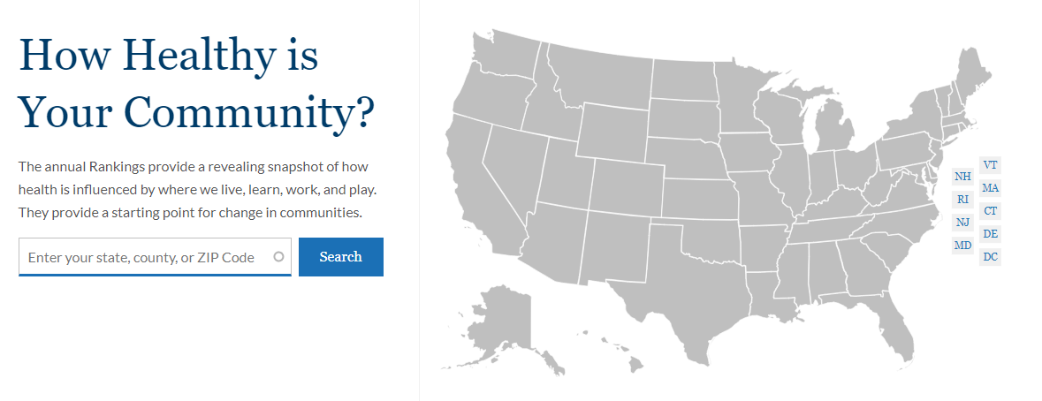
Notes:
KEY POINTS
You can find information for your state and county four different ways:
Clicking on your state on the map on the CHR&R homepage
Entering your county name in the search bar to the left of the map on the CHR&R homepage
On our “Explore Health Rankings” page (Click on the orange bar shown)
Typing in your state or county name in the main website search bar (click on the magnifying glass in the orange bar shown)

Slide 12
Tips for presenting your county’s data
Start with your county’s Health Outcomes and Health Factors ranks.
Discuss the context of those ranks.
Look at your county’s ranks for each Health Factor.
Discuss the context of those ranks.
Examine the measures
Notes:
Note to Presenter: Slide hidden. For facilitation purposes only.

Slide 13
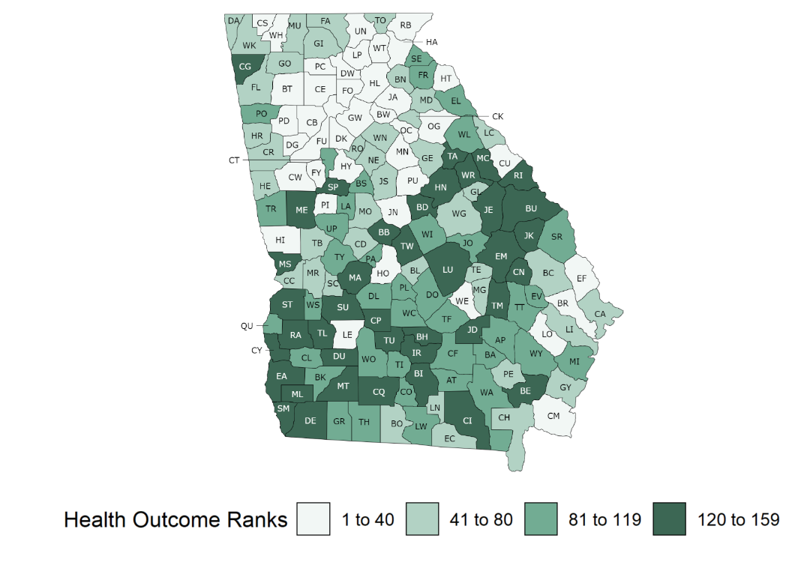
Health outcomes Ranking
Fulton County ranks 13 out of 159 counties
Notes:
KEY POINTS
At county health rankings we provide both health outcome and health factor ranks. The health outcome rank measures the length and quality of life in counties within a state.
You can see here Fulton County, Georgia where Atlanta is located ranks 13th out of 159 counties for health outcomes.
This map shows the counties broken into quartiles where lighter performing counties are the healthier ranked counties.

Slide 14
Health Factors Ranking
Fulton County ranks 27 out of 159 counties
Notes:
KEY POINTS
Fulton County, GA ranks 27th out of 159 counties for Health Factors which is the composite score of measures that fall into categories of health behaviors, clinical care, social and economic factors, and the physical environment.
If your overall rank for health outcomes is better than your rank for health factors, like in this case, this suggests that if you take no further action, your health outcomes rank may decline in the future.

Slide 15
Health behaviors Ranking
Fulton County ranks 17 out of 159 counties
Notes:
KEY POINTS
Health behaviors includes things like diet & exercise, alcohol & drug use, tobacco use, and sexual activity.
Fulton County, GA ranks 17th out of 159 counties for Health Behaviors.
POTENTIAL DISCUSSION QUESTIONS
What do you notice about our county’s rank compared with the state?
What surprises you about this rank?
What are you curious about?
______________________________________
NOTES TO PRESENTER:
If your overall rank for health outcomes is better than your rank for health factors, this suggests if you take no further action, your health outcomes rank may decline in the future. If your health outcomes rank is worse than your health factors rank, your health outcomes rank may improve in the future.
CUSTOMIZE FOR YOUR COMMUNITY
Enter your county’s name, rank, and the number of counties in your state.

Slide 16
Clinical care Ranking
Fulton County ranks 5 out of 159 counties
Notes:
KEY POINTS
Clinical Care includes things like access to care and quality of care.
Fulton County, GA ranks 5th out of 159 counties for clinical care.
POTENTIAL DISCUSSION QUESTIONS
What do you notice about our county’s rank compared with the state?
What surprises you about this rank?
What are you curious about?
______________________________________
NOTES TO PRESENTER:
If your overall rank for health outcomes is better than your rank for health factors, this suggests if you take no further action, your health outcomes rank may decline in the future. If your health outcomes rank is worse than your health factors rank, your health outcomes rank may improve in the future.
CUSTOMIZE FOR YOUR COMMUNITY
Enter your county’s name, rank, and the number of counties in your state.

Slide 17
Social & economic factors Ranking
Fulton County ranks 47 out of 159 counties
Notes:
KEY POINTS
Social and economic includes things like education, employment, income, family & social support, and community safety.
Fulton County, GA ranks 47th out of 159 counties for Social & Economic Factors.
POTENTIAL DISCUSSION QUESTIONS
What do you notice about our county’s rank compared with the state?
What surprises you about this rank?
What are you curious about?
______________________________________
NOTES TO PRESENTER:
If your overall rank for health outcomes is better than your rank for health factors, this suggests if you take no further action, your health outcomes rank may decline in the future. If your health outcomes rank is worse than your health factors rank, your health outcomes rank may improve in the future.
CUSTOMIZE FOR YOUR COMMUNITY
Enter your county’s name, rank, and the number of counties in your state.

Slide 18
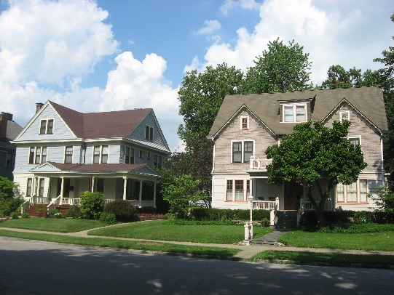
Physical environment Ranking
Fulton County ranks 154 out of 159 counties
This Photo by Unknown Author is licensed under CC BY-SA
Notes:
KEY POINTS
Physical environment includes things like air & water quality and housing & transit.
Fulton County, GA ranks 154th out of 159 counties for physical environment.
POTENTIAL DISCUSSION QUESTIONS
What do you notice about our county’s rank compared with the state?
What surprises you about this rank?
What are you curious about?
______________________________________
NOTES TO PRESENTER:
If your overall rank for health outcomes is better than your rank for health factors, this suggests if you take no further action, your health outcomes rank may decline in the future. If your health outcomes rank is worse than your health factors rank, your health outcomes rank may improve in the future.
CUSTOMIZE FOR YOUR COMMUNITY
Enter your county’s name, rank, and the number of counties in your state.

Slide 19
What does your Snapshot tell you?
Look at the big picture – health factor and health outcome ranks
Check your health factors – which are strongest? Which could use some work?
Look at your trends – especially premature death
Begin to explore the measures using Areas to Explore and Areas of Strength
Notes:
KEY POINTS
At the County Health Rankings we provide a snapshot of health data for key metrics. But what does your snapshot really tell you?
1. When you first look at your snapshot, try to get a sense of the big picture. The health factor and health outcome ranks can do that. These are in the right most column.
2. Next, check your health factors to see which are strongest and which might need some work. These are ranks for health behaviors, clinical care, social and economic factors and the physical environment.
4. Finally, explore the measures. Within each of these areas you can also look at the measures themselves. We provide county data with an error margin, a state level value as well as the national benchmark value which is the top 10% of counties.
Knowing what to focus on in your community will take more than looking at the Rankings data. But we include two tools that can give a head start. If you click on Areas to Explore and Areas of strength, you’ll see highlighted measures that are particularly worrisome or particularly great when compared to the state or national averages.
These comparisons don’t replace a true priority setting process, but they can give you a quick peek into strong and weak areas in your county that might be worth exploring further.

Slide 20
Examine the measures
Compare county values to the Top U.S. Performers
Compare county values to the state average
Look at the error margins
Look at the trends
Notes:
When you examine your measures you might want to understand how you are doing compared to previous years and to other places. Looking at changes in individual measures over time can help you measure your progress.
Compare your county to the Top U.S. Performers (the top 10% of US counties)
Compare your county values to the state average
Which measures are better than the state average? Which are worse?
3. Look at the error margins to find meaningful differences
4. Look at the trends. We include trend graphs for several measures. Find the graph icon in the Trend column of your county’s snapshot. The color of the line in the icon shows the direction of the measures in your county:
Red - Your county is getting worse for this measure
Yellow - Your county is staying the same for this measure
Green - Your county is getting better for this measure
[CLICK] Click on the graph icon for a specific measure. This will open a graph to allow you to see the datapoints overtime for your county, your state, and the US.
NOTE TO PRESENTER:
This slide is animated.

Slide 21
Examine the measures
Show areas to explore and areas of strength.
Dive deeper.
Notes:
If you select Areas to Explore and Areas of strength (checkboxes are available just above the snapshot), you’ll see highlighted measures that are particularly worrisome or particularly great when compared to the state or national averages.
These comparisons don’t replace a true priority setting process, but they can give you a quick peek into strong and weak areas in your county that might be worth exploring further.
Dive deeper.
Within counties, differences can also exist from one neighborhood or ZIP code to the next. These differences are not captured in the County Health Rankings data.
More detailed data for subgroups and for many other measures of health may exist at the state, county, and even city level. These can be found in our digging deeper page which includes other national as well as state data sources.

Slide 22
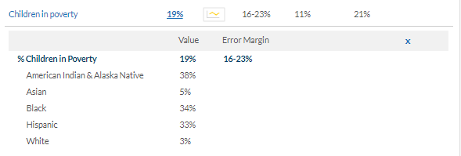
Examine the measures
Look at data breakdowns by race and ethnicity for any measure value that is blue and underlined
Dig deeper
Look at data breakdowns by race and ethnicity.
Dive deeper.
Notes:
Many of the CHR&R measures include data broken down by race/ethnicity. This is an opportunity to dive deeper into the data to compare meaningful differences within a county by race.
Any measure with the value that appears blue and underlined has additional disaggregated data available for it.
In 2020, CHR&R added data available for more racial and ethnic groups, adding Asian and American Indiana & Alaskan Native. You can now find data broken down into values for American Indian & Alaskan Native, Asian, Black, Hispanic, and White.
These measures also include error margins.
NOTE FOR PRESENTER:
If a measure breakdown is missing any of these race/ethnicities, it suggests that there was not enough data and the available data were suppressed.

Slide 23
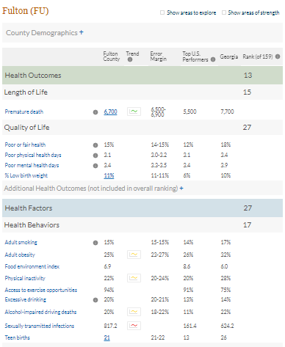
Additional Helpful features
Causes of death
Additional measures
Demographic data
Policies and programs
Spanish Translation
Notes:
Causes of death: If you click on the “i” that's next to “Premature Death” you can see the leading causes of death under age 75. We include as many of those causes as we can up to 5.
Additional Measures: On your snapshot, you’ll see that you can expand additional measures under Health Outcomes and several Health Factor areas.
These are measures that
Provide additional context to ranked measures
May not be available for all counties
Provide demographic information
Are not used to rank the health of your county
Demographic Data: We have made demographic breakdowns by race/ethnicity available for some measures, Children in Poverty is probably the best and most useful example.
Policies & Programs: One other thing we want to highlight from the measure detail page, is a link to policies and programs that can impact the measure you’re looking at. These are pulled from What Works for Health.
Spanish Translation: Click the blue Español button in the top right corner of your snapshot to see your snapshot in Spanish.

Slide 24
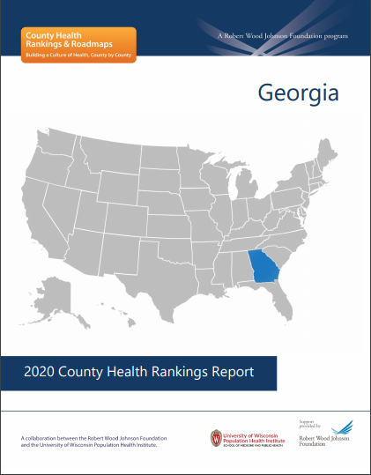
2020 State reports
Explores the link between children living in poverty and health
Differences by place and race, and how they came to be
Call to action to create opportunity and health for all
Find your state’s report: www.countyhealthrankings.org/state-reports
Notes:
We also release reports to go along with the data. The 2020 report explores the size and nature of health differences by place and race/ethnicity in your state and gives examples of actions state and community leaders can take to create environments where all residents have the opportunity to live their healthiest lives.
Through a series of graphics, our state reports illustrate how health outcomes and some health factor measures vary among counties and among racial and ethnic groups within states.

Slide 25
Interact with key indicators
Identify patterns among counties in your state and among racial/ethnic groups within counties
See how your state compares to all counties in the US
Explore your state’s data: www.countyhealthrankings.org/state-reports
Notes:
These new interactive graphics help to illustrate the size of the gaps that exist from one county to the next, and allow you to see patterns that arise when you dig deeper to look at differences among racial and ethnic groups within counties.
A series of guided questions help communities put the information into context and learn more about the patterns in their state. These questions can help communities understand:
How their state compares to the nation
How wide is the range between the counties in their state
How patterns differ by race or ethnicity
How other counties in the US compare, and what the patterns of those counties looks like
The pattern in these data should encourage us all to ask ‘why’? and to take a closer look at community conditions where we live, including past and present policies and systems in our communities that may be limiting opportunities for ALL families and children to thrive. You will notice similar, unfortunate patterns as you look to multiple states.
These interactive graphics are available for all states and for three key indicators (as of 3/18/20): Children in Poverty, Percent Low Birthweight, and Median Household Income.

Slide 26
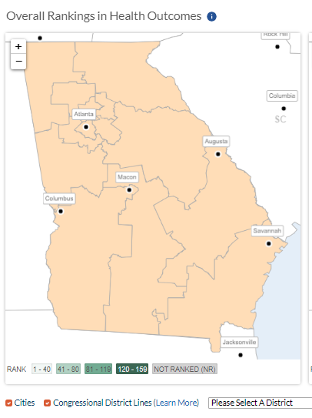
Congressional Districts
Available for Health Outcomes, Health Factors, and Measures
Identify geographic disparity
Understand how policy impacts health
Notes:
On your state page and measure pages you can now overlay city data as well as congressional district data.
This can be an informative way to look at your data.
When you select a congressional district it will pull up a box with all the counties that overlap that congressional district and their respective rank.
This can help identify additional geographic disparities and inform how policy impacts health outcomes.

Slide 27
Key Takeaways
Rankings are a starting point
To start or broaden conversations about health and equity
To draw attention to gaps by place and race
To prompt urgency on the issues influencing health
To move those conversations to action
Notes:
Rankings are a great starting point to draw attention to problems that matter in your community.
Don’t stop at the Rankings, turn to the data, and then most importantly use the data to drive action.

Slide 28
evidence
Taos Pueblo 2014
Using evidence to choose strategies that work
Notes:
KEY POINTS
Once you have used data to think about challenges and strengths, then its time to figure out what to focus on and how to improve it!
Our What Works for Health tool will help you find policies and programs that are a good fit for your community's priorities.
_____________________________________
NOTE TO PRESENTER
You can find What Works for Health under Take Action to Improve Health on the main navigation bar or at https://www.countyhealthrankings.org/whatworks
For each strategy included in What Works for Health, experts at the University of Wisconsin Population Health Institute search published and unpublished literature as well as the findings of credible organizations that assess evidence of effectiveness. Learn more about our methods here: https://www.countyhealthrankings.org/take-action-to-improve-health/what-works-for-health/our-methods

Slide 29
How do you select strategies currently?
Intuition or a gut feeling about what will be effective
Based on what you have heard others are implementing in your field
Consider past experience with similar situations and strategies you have used
Results of controlled experimental studies that show a method is helpful
What you know by critically reading the literature in the field
Notes:
KEY POINTS
What does evidence mean to you? Please consider how you currently select strategies:
1. Do you use your intuition or a gut feeling about what will be effective?
2. Is it based on what you have heard others are implementing in your field?
3. Do you consider past experience with similar situations and strategies you have used?
4. Do you examine the results of controlled experimental studies that show a method is helpful?
5. Or, do you factor in what you know by critically reading the literature in the field?
When we in WWFH think of evidence, we focus on options 4&5 [CLICK], which are the results of controlled experimental studies and critically reading the literature. They are important components, but, not the only things that should be considered.
POP-UP RELECTION QUESTION: What does evidence means to you?
NOTE TO PRESENTER
This slide is animated.

Slide 30
Notes:
KEY POINTS
At its core, WWFH is a tool to help communities make decisions about the strategies they can use to address local health priorities, and do so without reinventing the wheel each time. It really makes harnessing evidence easier for communities.
You may explore strategies by topic or using a keyword search; each offers additional filtering options to further refine your results.

Slide 31
evidence matters
Smart investments
Inform decisions
Inform innovation
Photo courtesy of UW-Madison University Communications
Notes:
KEY POINTS
When it comes to selecting, developing, and implementing solutions to problems that affect our communities, evidence matters.
Evidence can help
[CLICK 1] Drive smart investments and stretch the impact of scarce dollars
[CLICK 2] Help inform decisions about when to adopt ‘tried & true’ options and when to be more innovative, and to
[CLICK 3] Inform innovation: Knowing what has been shown to work – and what hasn’t –can help to ensure that innovative solutions are effective
NOTE TO PRESENTER
This slide is animated.

Slide 32
A menu of ideas
Evidence rating
Literature summary
Who
What
Cost
Disparity rating
Implementation examples & tools
Notes:
KEY POINTS
We provide a menu of ideas within WWFH, presenting the available evidence and examples of where strategies have been implemented. By strategies, I mean policy, program, systems, or environmental change.
What Works for Health is a living resource of over 400 evidence informed strategies. We have done the homework and literature review and you can explore to choose which strategy fits for your community.
For each strategy we include:
An evidence rating, which conveys the likelihood strategies will work based on best available evidence. It is core to what we do, and how this resource can be useful for you. It indicates which strategies have been shown to work, those that might work, and those shown NOT to work or cause harm
A short literature summary that highlights WHO a strategy can benefit, WHAT it can do, and, as we have it, information about cost
We also include disparity ratings, to help communities use an equity lens as they explore strategies
And implementation resources to move from idea to action

Slide 33
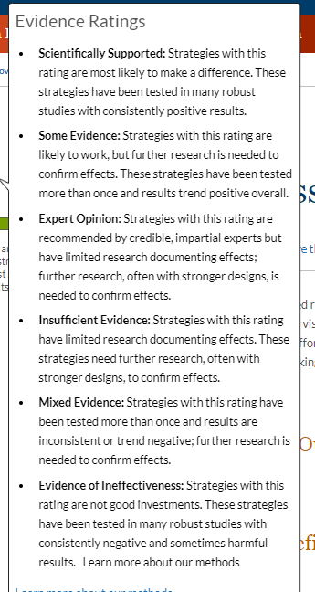
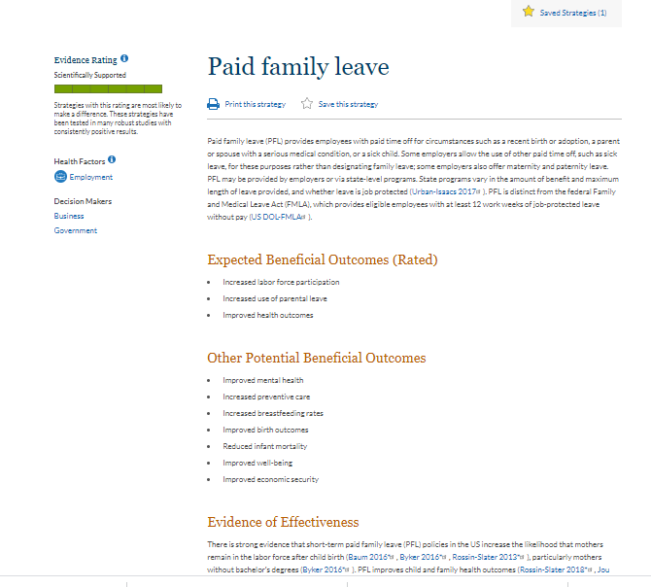
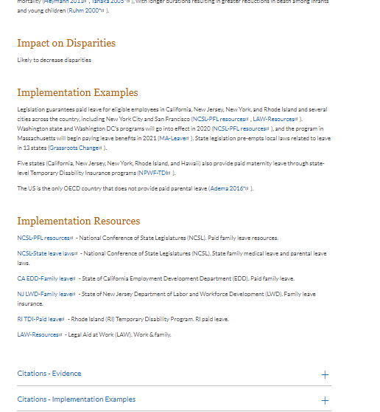
Notes:
KEY POINTS
Here you’ll see an example of what a strategy looks like on our newly updated website.
This is an abbreviated version of our Paid family leave entry, meant to provide a quick glimpse of what all of the elements we’ve outlined look like when they come together to form a strategy.
On each strategy’s page we include the title and a temperature gauge illustrating the Evidence Rating [CLICK 1--ARROW]; the completely green filled gauge indicates that this strategy is rated Scientifically Supported, which is our strongest Evidence Rating.
You can learn more about our Evidence ratings by clicking [CLICK 2—BOX OF EV RATINGS] on the blue “information” icon, here.
You’ll see icons like this throughout the site, please click them to learn more!
[CLICK 3—BOX AND ARROW LEAVE]
Turning back to the strategy, we include a description at the top, and then move down through the Expected Beneficial Outcomes and here have space for just a snippet of the Evidence of Effectiveness section, which is our literature summary.
[CLICK 5—RIGHT PANEL APPEARS]
Moving to the next panel, you’ll see our assessment of the Impact on Disparities, which communities indicate they especially appreciate, and Implementation Examples and Implementation resources, which we’ve heard undergrad and graduate students often use in program planning classes. Some strategies may also include a Community in Action story, offering even more information!
_____________________________________
NOTE TO PRESENTER
THIS SLIDE IS ANIMATED.
This slide shows only partial text, full entry is available here: https://www.countyhealthrankings.org/take-action-to-improve-health/what-works-for-health/strategies/paid-family-leave
This strategy was chosen because it was featured in the 2020 County Health Rankings Key Findings Report and is very timely with COVID-19.
Strategies are updated regularly. This strategy was last updated 8/6/18.

Slide 34
Notes:
KEY POINTS
For 2020, we have added some new features to make What Works for Health more user-friendly!
We now offer:
Improved filtering and search capabilities;
[CLICK 1] The option to print a two-page handout with strategy details;
[CLICK 2] The opportunity to save selected strategies to come back to at any time
[CLICK 3] Access to your customized list of saved strategies and the ability to either email or download them.
_____________________________________
NOTE TO PRESENTER
THIS SLIDE IS ANIMATED.
This slide shows only partial text, full entry is available here: https://www.countyhealthrankings.org/take-action-to-improve-health/what-works-for-health/strategies/paid-family-leave
This strategy was chosen because it was featured in the 2020 County Health Rankings Key Findings Report and is very timely with COVID-19.
Strategies are updated regularly. This strategy was last updated 8/6/18.

Slide 35
Save, Download, and share strategies
Keep track of strategies you want to explore
Share selected strategies via email
Download to print or share
Notes:
KEY POINTS
You can access the strategies you’ve starred throughout your visit to WWFH at the top right of your screen, similar to a shopping cart. Once you’ve created the list of strategies you’re interested in exploring further, you can download them to your computer or email them to yourself and your colleagues.
Only interested in sharing some of your selected strategies? Just choose the right ones and pass them along.
Your saved strategies list will remain intact and will continue to appear when you visit our website, www.countyhealthrankings.org, until you clear your cookies.

Slide 36
selecting a strategy: Evidence plus
Does the strategy work in a way that matters to you?
Evidence ratings + expected beneficial outcomes
Does the strategy make sense locally?
Evidence of effectiveness summary
Populations like yours? Communities like yours? Cost?
How might the strategy affect gaps?
How do you know what it really takes to implement?
Notes:
KEY POINTS
How can you identify which strategies you may want to select?
We like to suggest an approach we think of as “evidence plus.”
This approach connects the evidence you find in each strategy with your local culture and context. As you explore WWFH and read specific strategies, you’ll find content to support this approach.
To start, consider asking:
- [CLICK 1] Does the strategy work? Will it work here?
- Then, look at the details: [CLICK 2] Evidence ratings show the likelihood a strategy will work, based on best available evidence; there’s a field called expected beneficial outcomes that will show you what it is rated for.
- [CLICK 3] Confirm these outcomes matter to you. Reading the evidence of effectiveness summary can help you know if a strategy is likely to work locally—do you see populations like yours? Communities like yours?
- [CLICK 4] Disparity ratings indicate likely effects on disparities or gaps in expected outcomes, and
[CLICK 5] Implementation examples include toolkits, model policy language, and illustrations of how communities have put a strategy into action
-------------------
NOTE TO PRESENTER
THIS SLIDE IS ANIMATED.

Slide 37
Key Takeaways
Evidence is an important part of decision making (but not the only part)
What Works for Health provides information about what works, what might work, and what doesn’t work
Connect the evidence with your local culture and context

Slide 38
guidance
Richmond, VA 2017
Using guidance to put strategies into action
Notes:
KEY POINTS:
The work of transforming communities is not easy. We believe that by supporting communities with guidance about HOW TO TAKE ACTION and WHO TO WORK WITH, we can accelerate their progress toward improved health outcomes and health equity.
County Health Rankings & Roadmaps provides guidance in a few key ways:
For example, learning opportunities like our webinar series and more interactive discussion groups
Our online Action Center and Partner Center
Online resources like Action Learning Guides
Support from Action Learning Coaches

Slide 39
How communities create change
Take Action Cycle
Notes:
KEY POINTS:
This image illustrates HOW communities transform health and, at its center, WHO has a role to play in making it happen.
Our Action Center and Partner Center are grounded in the Take Action Cycle.
The guidance we provide helps communities work through each of these important steps in community change and consider the different types of people to work with along the way.
We know that action isn’t always linear and sometimes these steps overlap. You may find yourself moving back and forth between these steps. That’s OK.
However, we believe that it’s important:
To understand not just your community’s needs, but also its resources.
To select priorities, because if everything is important, nothing is …
To look to the evidence when considering what to do AND consider things like local context and priorities when selecting policies and programs that will work for you.
All of that work gains meaning when we actually take action on what is important and learn whether that action is doing what we set out to do through evaluation

Slide 40
How to Take Action: Action Center
Step-by-step guidance and tools
7 Action Steps
Key Activities and suggested tools to guide your progress
TIP: Bookmark the Action Center so you can return to find the right resources when you need them.
Visit the Action Center: http://www.countyhealthrankings.org/actioncenter
Notes:
KEY POINTS
The Action Center, which you will find under Take Action to Improve Health on our website, provides step-by-step guidance and tools to help you move with data to action.
The Action Center answers the question: How can we take action?
Each Action Step is broken down into key activities with guidance and suggested tools to support your work.
Consider where you are putting your efforts to help you get started:
For example, are you assessing your needs and resources or trying to choose effective policies or programs? You can choose the guides that are most useful for your stage of action.
You can also think about where you are feeling a little stuck.
Maybe you are having trouble moving from the assessing and planning to actually implementing the policy changes or programs you’ve selected. Then Act on What’s Important can help.
Maybe you struggle to keep your partners engaged or to recruit diverse stakeholders to your efforts, our Work Together guide can help.
Click into the guide that seems most useful, review the related Key Activities and choose the one that resonates with you.
The Action Center can also be used as a “just-in-time” resource that you revisit to find the right resources when you need them.

Slide 41
Who to work with: partner center
Provides guidance around:
Why different sectors might care about creating healthy communities
What they can do
How to engage them
TIP: If you don’t see yourself in any of the sectors listed in the Partner Center, start with Community Members.
Visit the Partner Center: http://www.countyhealthrankings.org/partner
Notes:
KEY POINTS
The Partner Center reminds us that we all have a role to play in creating healthier communities. By working together we can achieve more than working alone.
The Partner Center, which you can also find under Take Action to Improve Health on our website, is all about joining with others to make lasting change in your community. It answers the question: Who should we work with?
Think about the people in your community who make positive changes happen. We can call them leaders, changemakers, or stakeholders -- whatever you call them, these are the people you want to partner with. How do you reach them?
You start by doing some research to find out what their goals are and how they might align with yours.
Think about what is in it for them.
Find a way to get connected and begin to cultivate a relationship.
The Partner Center can help get you started. It provides guidance around:
Why different sectors might care about creating a healthy community
What they can do, and
How you can engage them.

Slide 42
Dig in: Action Learning GUides
Blend of guidance, tools, and hands-on practice to help you get started and support community change
Topics include:
Understanding and using data
Promoting health and equity
Focusing on factors that influence health
Notes:
KEY POINTS
CHR&R recently launched a new resource: Action Learning Guides.
They are self-paced, interactive guides that blend guidance, tools, and activities for hands-on practice and reflection. They are designed to support you and your partners as you as you deepen your learning on select topics. They can be used independently or with members of a group to collaboratively discuss the topic. You can find them on the Take Action to Improve Health page the County Health Rankings website. http://www.countyhealthrankings.org/action-learning-guides
Each guide features a companion worksheet that allows individuals to track their own progress through the topic or allows members of a group to collaboratively discuss the topic. Our first three guides are focused on introducing guide users to equity, on the importance of partnering with residents, and how to get started with policy change as pathways to improving community health.
Topics include:
Understanding and using data
Partnering with residents
Getting started with policy change
Promoting health and equity and more

Slide 43
Key Takeaways
The Action Center answers the question: How can we take action?
The Partner Center answers the question: Who should we work with?
The Action Learning Guides allow for a self paced exploration of the topics.
Our coaches can help you connect with any of the resources we talked about today.
Notes:
Carla
So, in summary:
The Action Center answers the question: How can we take action?
The Partner Center answers the question: Who should we work with?
The Action Learning Guides allow for a self paced exploration of the topics.
Our coaches can help you connect with any of the resources we talked about today.

Slide 44
Stories: Learn from others
Columbia Gorge Region, OR and WA 2016
Sharing stories ignites possibilities and inspires action
Notes:
Sharing the stories of others ignites possibilities and inspires action. Our Learn From Others section provides multiple ways to find out more about what other communities are doing. You can:
Find out about our upcoming webinars or watch archived videos highlighting community stories.
Read about the journeys community have taken in our Community Highlights section
Or Learn more about the RWJF Culture of Health Prize.
Photo: Columbia Gorge Region, OR and WA. 2016 Culture of Heath Prize winner.

Slide 45
RWJF Culture of Health Prize
San Pablo, CA 2017
Honors and elevates U.S. communities that are making great strides in their journey toward better health for all.
Notes:
KEY POINTS
Another important part of the work that we do is The RWJF Culture of Health Prize.
The Robert Wood Johnson Foundation Culture of Health Prize honors and elevates U.S. communities that are making great strides in their journey toward better health. Prize-winning communities have placed a priority on health and are creating powerful partnerships and deep commitments that will enable everyone, especially those facing the greatest challenges, with the opportunity to live well.
Photo: San Pablo, CA. 2017 Culture of Heath Prize winner.

Slide 46
RWJF Culture of Health Prize criteria
Defining health in the broadest possible terms.
Committing to sustainable systems changes and policy-oriented long-term solutions.
Creating conditions that give everyone a fair and just opportunity to reach their best possible health.
Harnessing the collective power of leaders, partners, and community members.
Securing and making the most of available resources.
Measuring and sharing progress and results.
Notes:
KEY POINTS
The six Prize criteria displayed on this slide drive the selection of Prize winners, and we believe are applicable and have value to any community working to improve.
You can find more details on the elements of each criterion and updates on the call for applications at www.countyhealthrankings.org/prize
Potential discussion questions:
How does our community reflect these criteria?
Which criteria does our community most embody? Which criteria is our community still working toward?
What are we most proud of in our community?

Slide 47
RWJF Culture of Health Prize Winners, 2013 – 2019
Learn more about each winning community at: www.rwjf.org/prize
Notes:
KEY POINTS:
44 communities have now been designated as RWJF Culture of Health Prize winners.
The winning communities span 26 states, including 5 native nations. You can see that the Prize recognizes all types of places – cities, counties, tribes, small rural towns and interconnected regions – representing a wide range of physical, economic, and demographic characteristics. These places and their journeys are each unique but they all show us what a Culture of Health can look like.

Slide 48
Hear their stories
Learn more about each winning community with videos and stories: www.rwjf.org/prize
Notes:
KEY POINTS
Finally, we often get asked for specific examples of communities that are building a Culture of Health. For this we really encourage you to visit rwjf.org/prize and look at the videos and stories of the 44 Prize winners and learn from them.
Such as the 2019 Winners are:
Broward County, FL
Gonzales, CA
Greenville County, SC
Lake County, CO
Sitka, AK

Slide 49
New Resources Featuring Prize Winners
Highlights first five years of Prize Winners
Examples of strategies to ensure everyone has a fair and just opportunity for health
Read the full Actions Toward Equity Report: www.countyhealthrankings.org/reports
Notes:
We also want to briefly highlight a new resource that features more information about past Prize-winning communities:
The Actions Toward Equity report, which highlights work across the first five years of Prize Winners, which may be of interest to you. The report includes specific examples of strategies communities are using to ensure everyone has a fair and just opportunity for health. Use the “contact us” button on our website to order one or many sent to you (no charge) or download directly from the address on the screen.

Slide 50
Stay connected
Facebook.com/CountyHealthRankings
Follow @CHRankings
Sign up for our newsletter CountyHealthRankings.org/subscribe

Slide 51
Contact us at: www.countyhealthrankings.org
THANK YOU!

